Slide 1

LOSS Team Training
Frank R. Campbell, Ph.D., LCSW, CT
LOSSTeam developer
Materials presented are © copyright protected and should not be copied without permission of the presenter.

Slide 2

Welcome to Bayou Self
Population=6
This is a story about:
1. Marie
3. Pierre
5. Tom
2. Luke
4. Sue
6. Shane
Notes:
Exploring our values in the role of helper
Tell story – high school seniors having a party – at school Luke asked Marie if she is going and hopes he will see her there. Marie has had a crush on Luke all year.
Marie needs a ride and asks Pierre to take her
Pierre says sure – but first you have to have sex with me
Marie reluctantly agrees b/c she wants to see Luke
At party, Marie is upset and talks with Sue about what happened with Pierre …………………………
Rank characters – Discuss
Now there’s a little bit more to the story – Would you rank them differently?
What does this story have to do with being part of an outreach team to people with loss to suicide?
Assumptions – Blame – Guilt – Shock-
How could our biases create barriers as caregivers?

Slide 3
Crisis Theory
A crisis is the inner state (emotions) of a person reacting to stress (life pressures) when “normal” coping mechanisms have broken down.
A crisis is time limited.
A crisis is self-defined – it varies from person to person.

Slide 4
Crisis Theory
coping
Level of coping is indicated by:
Participation in a supportive community
Physical well-being
Control over daily activities
Productive and creative life
Hazardous Atmosphere
(High)
stressors
adaptive
i
f
e
PE
restoration
COPING
SA
full crisis
maladaptive
supports
(Low)
TIME
suicide

Slide 5
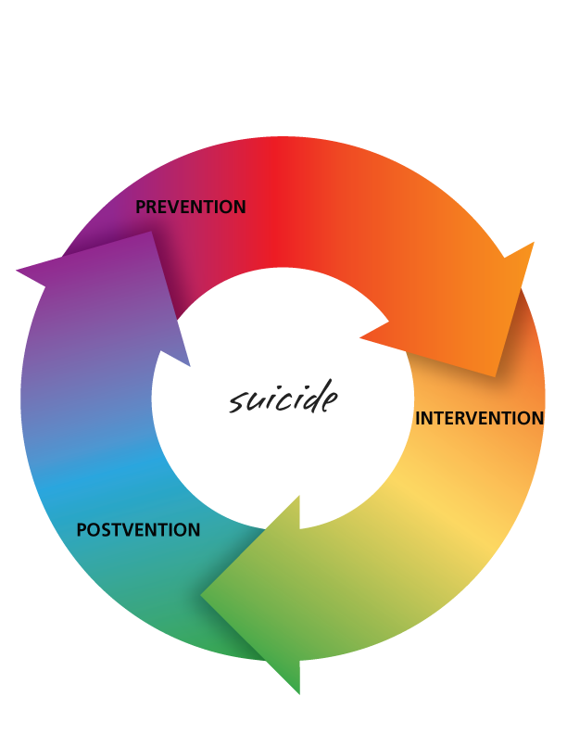

Slide 6
Postvention is prevention for the next generation
Edwin Shneidman Ph.D. (1972)

Slide 7
History of the LossTeam Concept
Passive (SOS find resources)

Slide 8
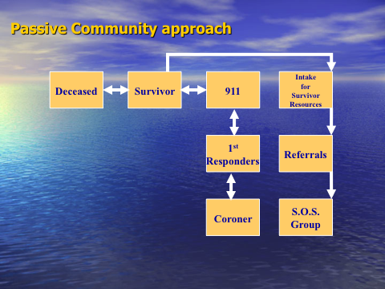


Slide 9
Changing the approach to Active
Reviewed SOS data from 1989-1994 (Bland-BRCIC data n=214)
28 relationships sought help (after loss = 45)
Elapsed time between loss and help= 3.4 years
Active (resources find SOS at the scene)
Elapsed time <47 days (10 year average)
Goal=REFER SOS to Services!

Slide 10
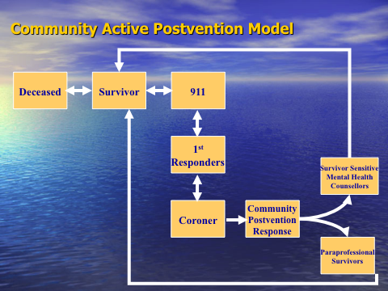

Slide 11
Video
SOS those left behind 2004 (3rd Discovery Documentary)
Changing the legacy of Suicide (2009 update to Discovery documentaries)

Slide 12
TRAUMA
GRIEF

Slide 13
Top Ten rankings by Relationship (seeking services) in 7 year study (n=345/415 or 83%)
Mother of the deceased
Sister of the deceased
Wife of the deceased
Daughter of the deceased
(tied) Friend-Son of the deceased
Father of the deceased
Brother of the deceased
Girlfriend of the deceased
Stepfather of the deceased
(tied) Cousin-Fiancée of the deceased

Slide 14


