Slide 1


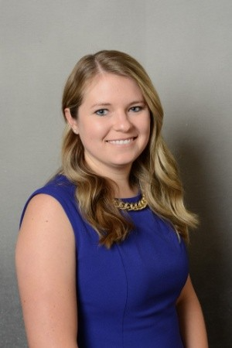
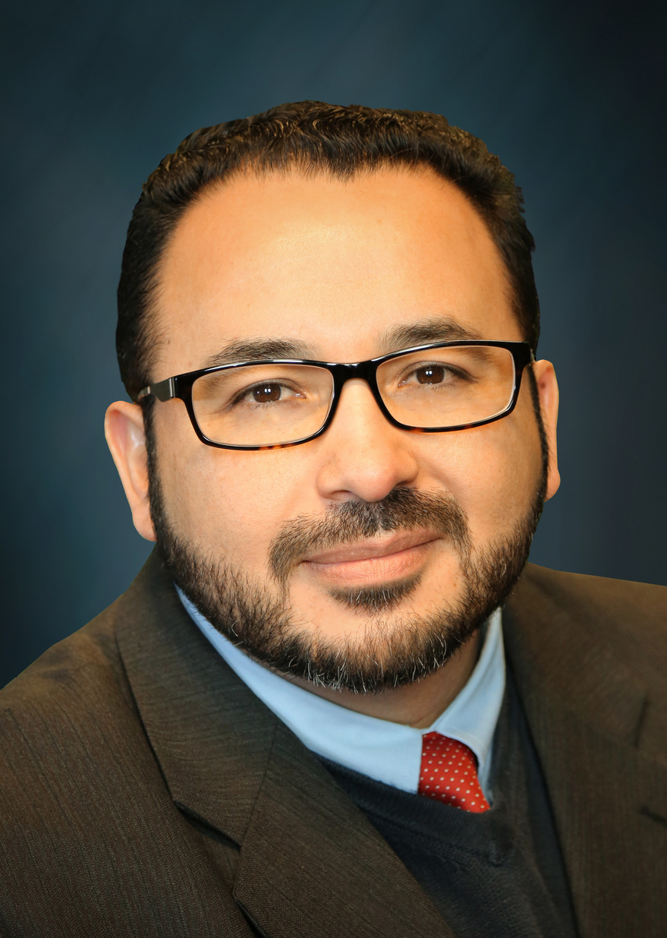





BEYOND THE NUMBERS: OHIO DEPARTMENT OF HEALTH AND SUICIDE PREVENTION
Mary DiOrio, M.D., MPH
Medical Director, Ohio Department of Health
Abby Hagemeyer, Ph.D., MPH
Violence and Injury Epidemiology and Surveillance Section, Data Administration Manager Ohio Department of Health
Socrates Tuch, J.D., MA
Senior Legal Counsel and Privacy Officer Ohio Department of Health
NOVEMBER 12, 2024
COLUMBUS, OHIO
OHIO SUICIDE FATALITY REVIEW BEST PRACTICES SUMMIT

Slide 2


Beyond the Numbers: Ohio Department of Health and Suicide Prevention
Nov. 12, 2024
Mary DiOrio, MD, MPH
Abby Hagemeyer, PhD, MPH
Socrates H. Tuch, MA, JD, CPM
Notes:
Dr. DiOrio- please feel free to add any background information, professional experience/anecdotes about connections to the work etc.
Good morning, I am so pleased to be with you today and happy to see the number of people here who share in this important work.
Introduce self, background, experience.

Slide 3

Learning Objectives
Participants will be able to identify at least one statewide activity to prevent suicide deaths being implemented by the Ohio Department of Health (ODH).
Participants will understand the burden and identify recent trends in suicide deaths among Ohioans.
Participants will identify where to find information about establishing a Suicide Fatality Review (SFR) Committee in the Ohio Revised Code.
Notes:
Today, I’m going to provide you with updates on the statewide initiatives happening at the Ohio Department of Health.
Abby Hagemeyer is going to walk you through the data, and then Socrates Tuch will provide an overview of the Ohio Revised Code as it relates to the Suicide Fatality Reviews.

Slide 4
ODH Suicide Prevention Activities
Dr. Mary DiOrio, MD, MPH, Medical Director

Slide 5
Disclosure
I have no financial interests or relationships to disclose.
Notes:
Please have MDO enter a disclosure statement

Slide 6

State Priority
Suicide Prevention is a priority in the State Health Improvement Plan-mental health and addiction.
Bureau of Health Improvement and Wellness, Violence and Injury Prevention Section with three dedicated positions.
Notes:
Suicide Awareness ribbon image from: Here
https://www.bing.com/images/search?q=suicide%20prevention%20purple%20and%20teal%20ribbon&view=detailv2&form=IQFRBA&id=E0CE370605D5124CB4ABC2AD574433B6AF270508&selectedindex=5&expw=940&exph=788&ccid=49ygGHsy&ck=10386CCD7DC2032A9702A17259317FC4&thid=OIP.49ygGHsyLqXn-5LOyqBE6AHaGN&idpbck=1&ajaxhist=0&ajaxserp=0&simid=607989803197215473&mediaurl=https%3A%2F%2Friverwoodhealthcare.org%2Fwp-content%2Fuploads%2F2022%2F09%2Fsuicideprevention_ribbon.png&cdnurl=https%3A%2F%2Fth.bing.com%2Fth%2Fid%2FR.e3dca0187b322ea5e7fb92cecaa044e8%3Frik%3DCAUnr7YzRFetwg%26pid%3DImgRaw%26r%3D0&vt=0&sim=11&pivotparams=insightsToken%3Dccid_RGAnzTJc*cp_2D6F5B9E09A6C19EF07EBF646A0F14FC*mid_EC173F65F626EDC59784A4F919A96DA7365A85B9*simid_608046363602208505*thid_OIP.RGAnzTJc0Moz2ikB1-aqlwAAAA&iss=VSI&ajaxhist=0&ajaxserp=0
SHIP-Suicide prevention is located within one of the three priority outcomes related to mental health and addiction.
Located in BHIW with three dedicated positions: Suicide Prevention Coordinator, Sarah Lee Jefferson; Epi 3 and Social Science Program Evaluator-TBD.
Tiffany Boykins in the Health Planning Administrator in this area.

Slide 7




ODH Initiatives
Youth Suicide Coalition.
Participation in the Suicide Prevention Plan for Ohio Workgroup.
Adult Male Workgroup.
Ohio School Safety and Violence Prevention Workgroup.
Notes:
Images from PowerPoint stock.
ODH Initiatives:
Administration of the Ohio Youth Suicide Coalition- this involves a multisector partnership with state and local partners that was formed in 2022 and follows the State of Ohio Youth Suicide Strategic Plan, which many community partners were involved in creating. The Ohio Youth Suicide Coalition meets bimonthly and is working to promote and share resources and ideas to help our partners implement suicide prevention activities for youth, ages 10-24, in their communities and across the state. If you haven’t heard of this coalition but would like to be a part, please let us know and we can get you signed up.
Adult Male Workgroup-The Ohio Suicide Prevention Foundation is partnering with ODH to form a workgroup for the adult male population. This workgroup will create an action plan that involves collaboration, data collection, communication and dissemination, and implementation of select activities. This will give Ohio an opportunity to expand approaches statewide while still prioritizing those high burden counties. Look for information about joining this group near the end of the year, beginning of next year.
Ohio School Safety and Violence and Prevention Workgroup led by the Ohio Department of Education and Workforce- there are several bureaus within ODH that participate in this monthly workgroup to discuss safety and violence prevention for schools, which addresses both bullying, harassment and violence of students. This group has created modules for the schools to utilize, including one to recognize the signs and symptoms of suicide and how to respond.
The Suicide Prevention Plan for Ohio 2024-2026-The Ohio Suicide Prevention Foundation and the Health Policy Institute of Ohio facilitated the creation of this state plan with funding from OhioMHAS. The Ohio Department of Health had several members involved in the advisory team for this plan and the state’s first suicide prevention plan that was released in 2020. The second plan was released at the beginning of 2024.

Slide 8
ODH Initiatives- Funding
Comprehensive Suicide Prevention Grant.
Youth Suicide Prevention Grant.
Adult Male, Age 24-59.
Pediatric Mental Health Care Access Grants.
Public Health Fund.
Notes:
Images from PowerPoint stock.
ODH Initiatives:
Secured first funding at ODH for suicide prevention with the Comprehensive Suicide Prevention Grant. This is a 4-year grant and includes multisector partnership planning, surveillance, evaluation, communication and dissemination, and implementation of evidence-based strategies within two disproportionally affected populations, youth ages 10-24 and adult males, ages 25-59. Much of the youth work will be completed by the Youth Suicide Grantees, in combination with the Ohio Youth Suicide Prevention Coalition multisector partners. The male work with be completed through a contract with the Ohio Suicide Prevention Foundation who will form a workgroup to focus on select evidence-based strategies while prioritizing those counties with the highest burden among this population: Lucas, Montgomery, Hamilton, Clark, Marion, Richland, Cuyahoga, and Mahoning.
March 1, 2024-released first Youth Suicide grantee program (for ages 10-24), where 6 grantees from high burden counties are able to have dedicated funding to address youth suicide in their communities. Each funded partner has selected evidence-based strategies that involve community-based, healthcare system, and upstream approaches, all of which were required to come from the Center for Disease Control and Prevention Suicide Prevention Resource to Action guide. At this time, Allen, Franklin, Delaware, Licking, Huron and Portage counties are funded. For year 2, which just started in September, 5 of the 6 are also working to enhance their local SFR Committees. Activities selected include trainings to identify and support people at risk through Question, Persuade, Refer programming and Virtual Hope Box; creating protective environments through safe storage practices safety planning, and Counseling on Access to Lethal Means; teaching coping and problems solving skills for year 1 college students to promote resiliency. Each funded partners is required to work very closely with their local suicide prevention coalition and ADAMH boards.
Pediatric Mental Health Care Access Grants and Advisory Committee-ODH was awarded a grant from the Health Resources and Services Administration (HRSA) in 2023 to establish a Pediatric Mental Health Care Access Program in Ohio. This programs provide pediatricians and other child and adolescent primary care providers (i.e. family physicians, nurse practitioners, etc.) training in mental health and direct access to mental health experts via teleconsultation. Pediatric mental health care teams will provide tele-consultation, training, technical assistance, and care coordination support for pediatric primary care providers to diagnose, treat, and refer, as needed, children with behavioral health conditions. In Ohio, ODH is contracting with the Government Resource Center (GRC) at the Ohio State University and the Ohio Chapter of the American Academy of Pediatrics to plan, implement and evaluate various aspects of the project. In addition, to this overall project, there is an advisory committee that meets regularly to discuss statewide activities involving this topics.
Public Health Fund of Ohio- The Public Health Fund of Ohio was created in July 2020 to supports ODH’s mission of advancing the health and well-being of all Ohioans and also support ODH’s SHIP. The PHFO is a supporting organizations through the Greater Cincinnati Foundation and managed by the HealthPath Foundation. Seven local suicide coalitions were funded to expand evidence-based strategies in their communities. Those coalitions funded included the counties of Cuyahoga, Darke, Hamilton, Highland, Licking, Logan, Lucas, and Pike.

Slide 9




Statewide Initiatives Data & Reporting
SFR Manual.
Weekly Data Summary.
Ohio Suicide Report.
Provide guidance and collect Suicide Fatality Review Annual Reports.
Notes:
Icons from PowerPoint stock
Suicide Fatality Review Manual- ODH and OhioMHAS worked with stakeholders throughout Ohio in a workgroup to create this manual to help guide existing SFR Committees and new communities who wish to establish a SFR Committee.
Weekly Data Summary-The Violence and Injury Epidemiology Surveillance Section releases a weekly summary to key state partners about Ohio ED visits for suspected attempts and suspected suicidal ideations. This data is used as indicators for trends in suicide.
Released guidance (written and video) for SFR Committee implementation and annual report guidelines. ODH worked with community-based partners to create a training video for guidance on establishing an SFR. ODH also developed guidance for those with established SFR for annual reports. Both of these can be found on the ODH website. As a reminder, if you have an active SFR Committee, the previous Calander years annual report is due to ODH by April 1 of the following year.
Ohio School Safety and Violence and Prevention Workgroup led by the Ohio Department of Education and Workforce- there are several bureaus within ODH that participate in this monthly workgroup to discuss safety and violence prevention for schools, which addresses both bullying, harassment and violence of students. This group has created modules for the schools to utilize, including one to recognize the signs and symptoms of suicide and how to respond.

Slide 10

Store It Safe Quality Improvement Project
Partnership with Ohio Chapter, American Academy of Pediatrics.
Behavioral health screening-depression and suicide screening with counseling on access to reduce lethal means.
Provider education and Maintenance of Certification credits.
Prioritize high risk counties for youth suicide.
Planning for wave 3 of this project.
Notes:
Logo from Ohio AAP website. https://ohioaap.org/ohio-aap-teen-store-it-safe-suicide-prevention-qi-program-to-help-you-screen-intervene-and-seek-treatment. ODH has permission to use.
Store It Safe- In 2022, ODH entered into a partnership with the Ohio Chapter, American Academy of Pediatrics, to implement a quality improvement project for behavior health screenings for adolescents at visits. This project is part of Core State Violence and Injury Prevention Grant with CDC, although several other funding sources are leveraged for this project.
The Store it Safe QI project involves recruiting pediatric and family providers across high burden youth suicide counties being trained to screen youth for both depression and suicide, in addition to providing counseling on access to lethal means to all caregivers. This project empowers the providers to identify and address the risk of suicide at all encounters with adolescents. Providers are trained on using the tools, as well as how to provide resources for discussions with all families to ensure there is a plan in place for eventual times of crisis, where applicable. Providers are provided safe storage options (lock boxes and gun locks) to offer all caregivers, along with educational information on safe storage and where to find resources.
There have been two waves for this project with a 3rd wave being recruited for.
In Wave #2, Ohio AAP partnered with 19 practices who screened 2,749 youth for depression and 2,622 for suicide. Caregiver survey indicated that only 15% of families ever had a professional talk to them about safe storage outside of that appointment with the pediatric provider, and only 23% did for family providers. Several screening resulted in treatment plans being implemented and continued. Initially the providers were only doing the screening at annual well-visits, but then moved to every visit.

Slide 11
Ohio Suicide Data
Abby Hagemeyer, PhD, MPH

Slide 12
Number and Age-Adjusted Rate¹ of Suicide Deaths by Year,
Ohio, 2014-2023
1. At the time this data was pulled, population files from the federal government reflecting new national standards and methodologies were available for 2020 through 2023 only. Because of this change, the Ohio Department of Health (ODH) advises caution in comparing these rates to those from years prior to 2020, as indicated by the segmented line in the graphic.
Source: ODH Bureau of Vital Statistics. Includes Ohio residents who died due to suicide (underlying cause of death International Classification of Diseases, Tenth Revision [ICD-10], codes X60-X84, Y87.0, *U03).

Slide 13
Number of Suicide Deaths by Quarter,
Ohio, 2021-2024*
Source: ODH Bureau of Vital Statistics. Includes Ohio residents who died due to suicide (underlying cause of death ICD-10 codes X60-X84, Y87.0, *U03).
*2024 data is preliminary. Data updated Oct. 21, 2024.
Notes:
Add Q1 of 2024

Slide 14
Number of Suicide Deaths by Quarter,
Ohio, 2020-2024*
Source: ODH Bureau of Vital Statistics. Includes Ohio residents who died due to suicide (underlying cause of death ICD-10 codes X60-X84, Y87.0, *U03).
*2024 data is preliminary. Data updated Oct. 21, 2024.
Notes:
Add Q1 of 2024

Slide 15
Number of Suicide Deaths by Mechanism,
Ohio, 2019-2023
Source: ODH Bureau of Vital Statistics. Includes Ohio residents who died due to suicide (underlying cause of death ICD-10 codes X60-X84, Y87.0, *U03).

Slide 16
Percentage of Suicide Deaths by Mechanism and Sex,
Ohio, 2023
Source: ODH Bureau of Vital Statistics. Includes Ohio residents who died due to suicide (underlying cause of death ICD-10 codes X60-X84, Y87.0, *U03).

Slide 17
Percentage of Suicide Deaths by Mechanism and Age,
Ohio, 2023
Source: ODH Bureau of Vital Statistics. Includes Ohio residents who died due to suicide (underlying cause of death ICD-10 codes X60-X84, Y87.0, *U03).

Slide 18
Percentage of Suicide Deaths by Mechanism and Race/Ethnicity,
Ohio, 2023
Source: ODH Bureau of Vital Statistics. Includes Ohio residents who died due to suicide (underlying cause of death ICD-10 codes X60-X84, Y87.0, *U03).
Other race/ethnicity groups are not presented due to small numbers.
Notes:
Change teal to grey

Slide 19
Rate of Suicide Deaths by Age and Year,
Ohio, 2020-2023
Source: ODH Bureau of Vital Statistics. Includes Ohio residents who died due to suicide (underlying cause of death ICD-10 codes X60-X84, Y87.0, *U03).

Slide 20
Number of Suicide Deaths by Age and Sex,
Ohio, 2023
Source: ODH Bureau of Vital Statistics. Includes Ohio residents who died due to suicide (underlying cause of death ICD-10 codes X60-X84, Y87.0, *U03).

Slide 21
Rate of Suicide Deaths by Age and Sex,
Ohio, 2023
Source: ODH Bureau of Vital Statistics. Includes Ohio residents who died due to suicide (underlying cause of death ICD-10 codes X60-X84, Y87.0, *U03).

Slide 22
Age-Adjusted Rate of Suicide Deaths by Race/Ethnicity,
Ohio, 2020-2023
Source: ODH Bureau of Vital Statistics. Includes Ohio residents who died due to suicide (underlying cause of death ICD-10 codes X60-X84, Y87.0, *U03).
Other race/ethnicity groups are not presented due to small numbers.

Slide 23
Age-Adjusted Rate of Suicide Deaths by Race/Ethnicity and Sex,
Ohio, 2020-2023
Source: ODH Bureau of Vital Statistics. Includes Ohio residents who died due to suicide (underlying cause of death ICD-10 codes X60-X84, Y87.0, *U03).
Other race/ethnicity groups are not presented due to small numbers.

Slide 24
Average Age-Adjusted Rate of Suicide Deaths by County¹,
Ohio, 2020-2023
Source: ODH Bureau of Vital Statistics. Includes Ohio residents who died due to suicide (underlying cause of death ICD-10 codes X60-X84, Y87.0, *U03).
1. County is determined by county of residence.
*Rates are suppressed when there are fewer than 10 total deaths.

Slide 25
Contact Information for Data Inquiries
InjuryData@odh.ohio.gov

Slide 26
Ohio Revised Code, Suicide Fatality Review
Socrates H. Tuch, MA, JD, CPM

Slide 27
Disclaimer
This is not legal advice.
The opinions expressed are those of the speaker. opinions expressed do not represent the positions of the Ohio Department of Health or the State of Ohio.

Slide 28
R.C. 307.641 – The Start
County Commissioners may appoint a Health Commissioner (HC) to set up the committee.
Regional is an option.
If you already have one, you are grandfathered.
Just update to meet the statutes.

Slide 29
R.C. 307.642 – The Folks
The HC + 4 more: Chief of Police or Sheriff; Ex. Director of the ADAMH or the like; Public Health Official; Physician.
The County Coroner may be invited.
The majority may invite others.
No pay, but expenses incurred are okay unless employer has paid.

Slide 30
R.C. 307.643 - The Purpose
Promote suicide prevention.
Maintain a comprehensive database to see trends.
Make recommendations to community that might prevent suicides.
Letting ODH know of trends & patterns.

Slide 31
R.C. 307.644 & 307.645
The HC is the chair. (R.C. 307.644.)
Must wait until after the prosecution unless prosecuting attorney agrees. (R.C. 307.645.)
The investigator and prosecuting attorney shall notify the chair at the end of each. (R.C. 307.645.)

Slide 32
R.C. 307.646 – Data
Establish a secure system for collecting & maintaining data.
Collect data on each death.
By April 1, send a report to ODH.
The April 1 report to ODH is a public record.

Slide 33
R.C. 307.647 – Getting Data
Upon request, all shall provide a summary of medical information, other requested information, and information the provider thinks might be useful.
Committee can access confidential information, including coroner report.
No information in violation of R.C. 307.645.

Slide 34
R.C. 307.648, 307.649, & 307.6410
Providers of information are immune from civil liability for providing information. (R.C. 307.648.)
Committee members are immune from civil liability for committee work. (R.C. 307.648.)
All committee data, statements, & work products are confidential. (R.C. 307.649.)
Can have a suicide and overdose hybrid committee. (R.C. 307.6410.) overdose hybrid committee. R.C. 307.6410

Slide 35
QUESTIONS?
ODH.OHIO.GOV

