Slide 1






How to Apply Lessons Learned from Gaps Uncovered in SFRs into Local Action
NOVEMBER 12, 2024
COLUMBUS, OHIO
Kalynn Sommers
Allison Yurcak
Daniel Bennett
OHIO SUICIDE FATALITY REVIEW BEST PRACTICES SUMMIT

Slide 2
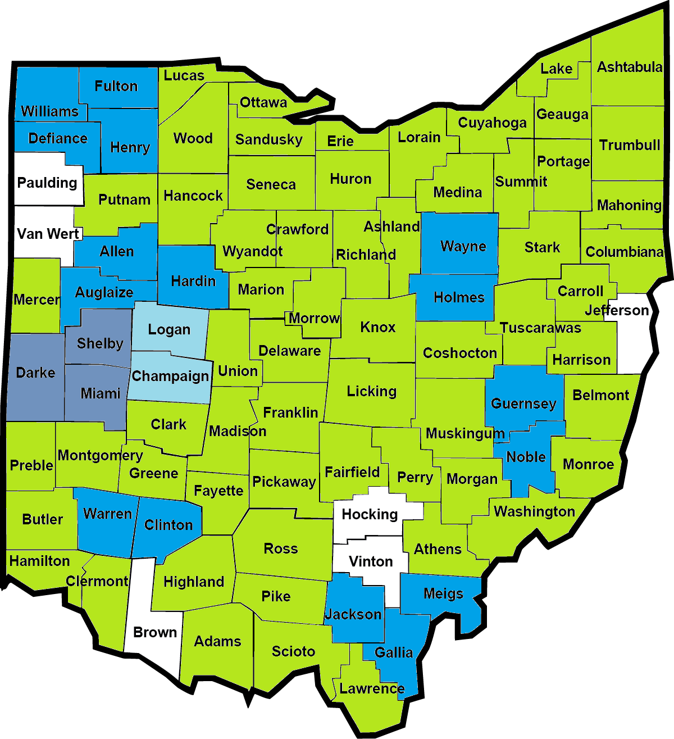
Coalitions Overview
  What is a coalition?
  What is a coalition qualified to do?
  What would/could the recommendation process look like?
NOVEMBER 12, 2024
COLUMBUS, OHIO
OHIO SUICIDE FATALITY REVIEW BEST PRACTICES SUMMIT

Slide 3
Coalition Example – Hancock County
  Hancock County Suicide Prevention Committee
  Purpose
  “Our community values and embraces suicide prevention through the expansion of protective and promotive factors. Most importantly, we persistently reinforce the benefits of connection for all community members as a primary suicide prevention strategy. Protective and promotive factors are threaded throughout all programming, supportive services, education, and awareness initiatives. This document outlines our strategic priorities, activities, and timelines to increase community awareness, expand education, reduce stigma, and improve data collection processes to create a comprehensive response to suicide prevention.”
  Frequency
  Meets bi-monthly in person or Zoom
NOVEMBER 12, 2024
COLUMBUS, OHIO
OHIO SUICIDE FATALITY REVIEW BEST PRACTICES SUMMIT

Slide 4
Coalition Example – Hancock County
  Hancock County Suicide Prevention Committee
  Members
  Family Resource Center
  National Alliance on Mental Illness (NAMI)
  Blanchard Valley Hospital
  Hancock Public Health
  Veteran Services
  Juvenile Court
  Findlay Police Department
  Hancock County Board of Alcohol, Drug Addiction and Mental Health Services (ADAMHS)
  50 North
NOVEMBER 12, 2024
COLUMBUS, OHIO
OHIO SUICIDE FATALITY REVIEW BEST PRACTICES SUMMIT

Slide 5
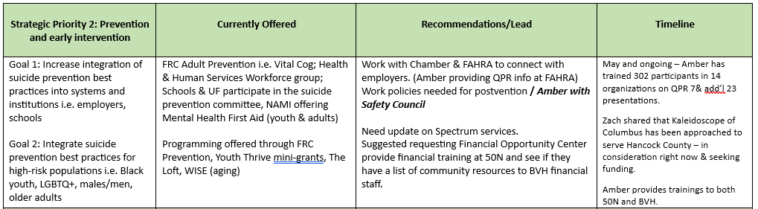
Coalition Example – Hancock County
  Hancock County Suicide Prevention Committee
NOVEMBER 12, 2024
COLUMBUS, OHIO
OHIO SUICIDE FATALITY REVIEW BEST PRACTICES SUMMIT

Slide 6
Coalition Example – Hancock County
  Hancock County Suicide Prevention Committee
  SFR Role in Suicide Prevention Committee
  Discuss previous and upcoming Fatality Review
  Relevant data regarding SI, SA, or died by suicide in Hancock County
  Recommendations
    Discuss previous and new recommendations
    Divide recommendations amongst relevant committee members
NOVEMBER 12, 2024
COLUMBUS, OHIO
OHIO SUICIDE FATALITY REVIEW BEST PRACTICES SUMMIT

Slide 7

Who Should Sit on the Review Board
  By Law Fatality Review Boards includes:
  Local Health Department
  Mental Health Board
  Licensed Physician
  Law Enforcement
  Coroner*
  Invited Additional Members*
  How do we get Coalitions involved?
  What barriers exist that might keep a coalition from participating?
NOVEMBER 12, 2024
COLUMBUS, OHIO
OHIO SUICIDE FATALITY REVIEW BEST PRACTICES SUMMIT

Slide 8

Ideally, How does this work?
  Let's talk about a fully functioning Fatality Review.
    Hancock County Suicide Fatality Review
      Introduction
        Review/clarify information from previous meeting
        Discuss rules of the review
      Case Review
        Discuss 3 deaths by suicide
        Discuss recommendations for each individual case
      Overall Recommendations
        Larger recommendations based on all cases presented
      Updates
        Community updates, recommendation updates
      Closing
NOVEMBER 12, 2024
COLUMBUS, OHIO
OHIO SUICIDE FATALITY REVIEW BEST PRACTICES SUMMIT

Slide 9
Ideally, How does this work?
      Hancock County Suicide Fatality Review- Case Example
      76 yr old male died by suicide. Later learn this individual has a history of depression, anxiety and PTSD. Spouse recently died and the decedent had no additional family or friends in the area. Pt goes to ED for SI. He reports he has no one and just wants to be with his wife. Pt is safety planned home due to lack of action plan.
NOVEMBER 12, 2024
COLUMBUS, OHIO
OHIO SUICIDE FATALITY REVIEW BEST PRACTICES SUMMIT

Slide 10
Ideally, How does this work?
      Hancock County Suicide Fatality Review- Case Example
      Recommendations?
      50 North
      Social support information provided during Crisis Screenings
      Outreach for widows/widowers
      76 yr old male died by suicide. Later learn this individual has a history of depression, anxiety and PTSD. Spouse recently died and the decedent had no additional family or friends in the area. Pt goes to ED for SI. He reports he has no one and just wants to be with his wife. Pt is safety planned home due to lack of action plan.
NOVEMBER 12, 2024
COLUMBUS, OHIO
OHIO SUICIDE FATALITY REVIEW BEST PRACTICES SUMMIT

Slide 11
Ideally, How does this work?
      Hancock County Suicide Fatality Review Recommendations
      Hancock County Suicide Prevention Committee
Ask 50 North if they have any resources or recommended courses of action
Ask Blanchard Valley Hospital if they provide patients with resources when they come in to get screened
  If not, can we change that
Grief support groups in Hancock County
NOVEMBER 12, 2024
COLUMBUS, OHIO
OHIO SUICIDE FATALITY REVIEW BEST PRACTICES SUMMIT

Slide 12

Recommendations
  Discussion at the meeting
  When do you make a recommendation?
  This process is not about assigning blame
    Coalitions are neutral
NOVEMBER 12, 2024
COLUMBUS, OHIO
OHIO SUICIDE FATALITY REVIEW BEST PRACTICES SUMMIT

Slide 13
NOVEMBER 12, 2024
COLUMBUS, OHIO
Thank You
OHIO SUICIDE FATALITY REVIEW BEST PRACTICES SUMMIT
For Your Attention

Slide 14




Contact Us
Allison Yurcak
(567)250-5199
Kaylnn Sommers
(513)818-3309
https://www.hancockph.com/
Hancock Public Health
2225 Keith Parkway, Findlay, OH 45840
ayurcak@hancockph.com
ksommers@hancockph.com

