Slide 1


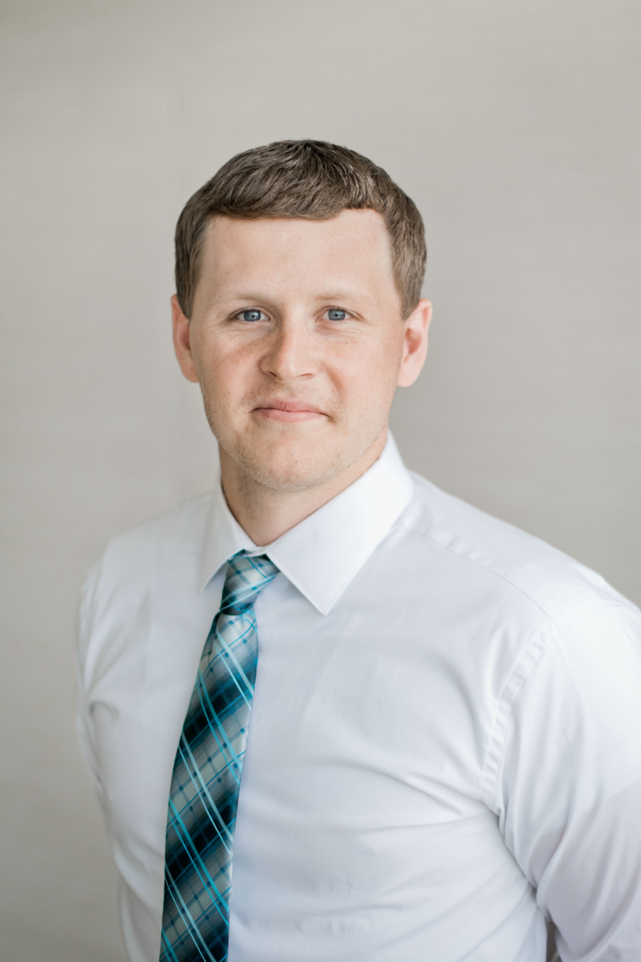

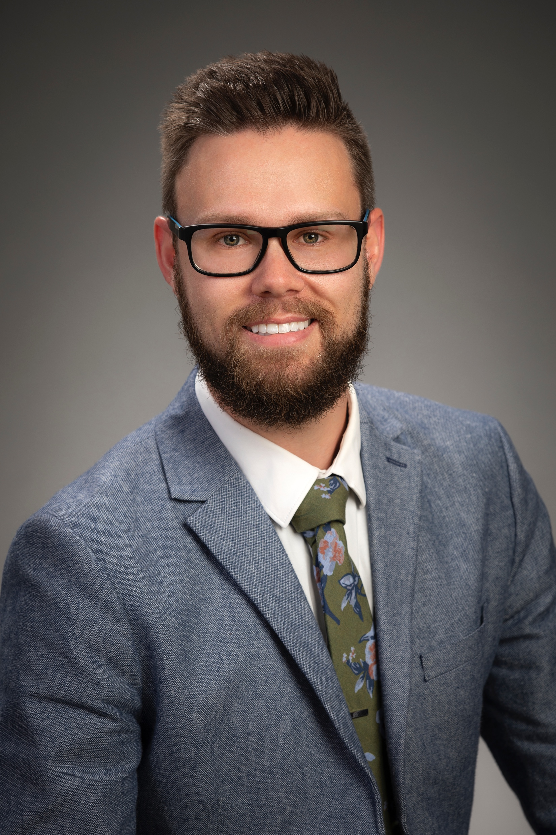



Suicide Death Investigations, Psychological Autopsy, and Connections to SFR
NOVEMBER 12, 2024
Dallas Allen, Franklin County Coroner’s Office
Austin Lucas, Ohio Suicide Prevention Foundation
COLUMBUS, OHIO
OHIO SUICIDE FATALITY REVIEW BEST PRACTICES SUMMIT

Slide 2

Suicide Investigations and Postvention Specialist
Dallas Allen
BA in Criminal Justice
  Muskingum University, 2017
Background in adolescent mental health
First Suicide Specialist in the nation
Completed 200+ psychosocial investigations
  Since July 2021
NOVEMBER 12, 2024
COLUMBUS, OHIO
OHIO SUICIDE FATALITY REVIEW BEST PRACTICES SUMMIT

Slide 3
Role of the Specialist
Roles
Importance
The specialist has two (2) primary functions:
  Interviewing Survivors for Psychosocial History
  Providing resources to Survivors
The specialist brings a unique perspective to the investigative unit and the Coroner’s team
The Information collected can be critical in determining cause and manner of death
This information can be used to inform public health initiatives and community intervention
NOVEMBER 12, 2024
COLUMBUS, OHIO
OHIO SUICIDE FATALITY REVIEW BEST PRACTICES SUMMIT

Slide 4
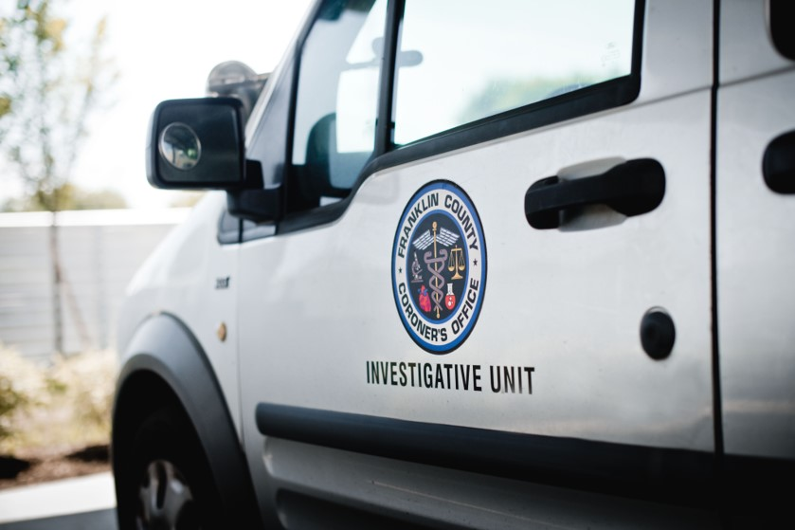
Activities of the Suicide Specialist
Daily Activities
Review all suspected suicide cases in Franklin County
Respond to suspected suicide death scenes
Assist investigators with suicide cases
Follow up with suicide survivors
Complete psychosocial reports to use in Suicide Fatality Reviews
NOVEMBER 12, 2024
COLUMBUS, OHIO
OHIO SUICIDE FATALITY REVIEW BEST PRACTICES SUMMIT

Slide 5

Equivocal Death Analysis
A common profile we see in local deaths are “ambivalent” suicides.
These are cases where there is both a strong history of accidental overdose as well as a reported history of suicidal ideation, stressors, or attempt(s)
Having the case reviewed through the lens of a specialist, when significant investigation is possible through psychosocial interviewing leads to more confident certifications of death
NOVEMBER 12, 2024
COLUMBUS, OHIO
OHIO SUICIDE FATALITY REVIEW BEST PRACTICES SUMMIT

Slide 6
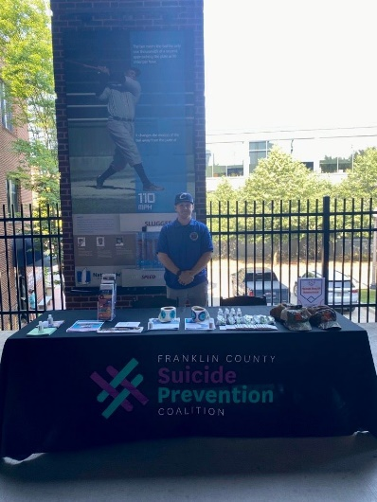
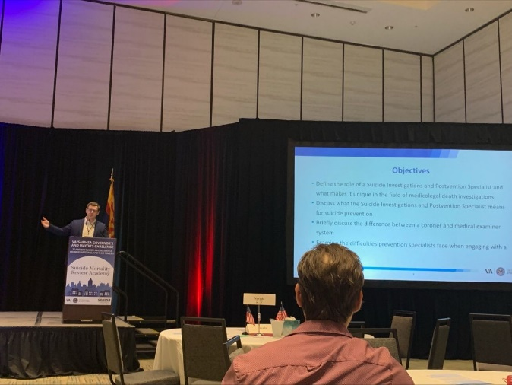
Community Involvement
Provide education at the federal level
  15 different states and counting
  No longer one of one
Multiple publications
  Recommendations for Local Suicide Prevention Infrastructure
  State-wide Best Practices for Suicide Fatality Review
Boards and committees
  LOSS Community Services
  Ohio Task Force for Criminal Justice and Mental Illness
  Franklin County Suicide Prevention Coalition
NOVEMBER 12, 2024
COLUMBUS, OHIO
OHIO SUICIDE FATALITY REVIEW BEST PRACTICES SUMMIT

Slide 7
Prevention in a Medicolegal Office
There have been several studies on this topic through the years.
Examples of these are:
  Embedding of social workers to work with survivors of violent deaths
  Fatality Reviews to develop recommendations on prevention and harm reduction
  Embedding of epidemiologists and statisticians to evaluate data for trends
NOVEMBER 12, 2024
COLUMBUS, OHIO
OHIO SUICIDE FATALITY REVIEW BEST PRACTICES SUMMIT

Slide 8

Turning Postvention into Prevention
Changing the way suicide is approached
Reactive → Proactive
More accurate data sets
Implementation is vital
Opportunity to create partnerships that otherwise may not have formed.
NOVEMBER 12, 2024
COLUMBUS, OHIO
OHIO SUICIDE FATALITY REVIEW BEST PRACTICES SUMMIT

Slide 9

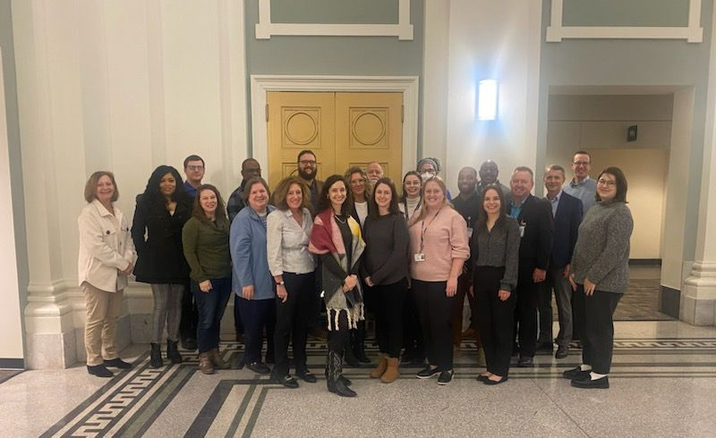
Franklin County Suicide Prevention Coalition
Actionable arm of the Suicide Fatality Review
Three action teams
  Communication
  Education
  Data and Research
Categorization of SFR recommendations
Creating a system to track implementation
Annual report
*First ever in-person All-Coalition meeting
NOVEMBER 12, 2024
COLUMBUS, OHIO
OHIO SUICIDE FATALITY REVIEW BEST PRACTICES SUMMIT

Slide 10
Psychological Autopsy
PAI investigations investigate further into psychosocial history and happen sooner after a suicide loss (3-9 months postmortem).
Procedure to understand the “why” and other factors.
Intersection of SFRs and PAIs has the potential to improve the local suicide prevention, intervention, and postvention initiatives in Ohio AND in other states.
  Invited by SAMHSA/VA to present Ohio model to 20+ states.
NOVEMBER 12, 2024
COLUMBUS, OHIO
OHIO SUICIDE FATALITY REVIEW BEST PRACTICES SUMMIT

Slide 11
Psychological Autopsy
  What goes into Psychological Autopsy investigation?
    All death information (provided by coroner, police reports, physical autopsy reports, witnesses, etc.)
    Demographic information
    Family/friend/next-of-kin/key informant interviews
    Medical history, SUD history, MH history
    Last points of care/contact
    Systems the decedent was involved in
    Suggestions on how similar suicides could potentially be prevented
NOVEMBER 12, 2024
COLUMBUS, OHIO
OHIO SUICIDE FATALITY REVIEW BEST PRACTICES SUMMIT

Slide 12
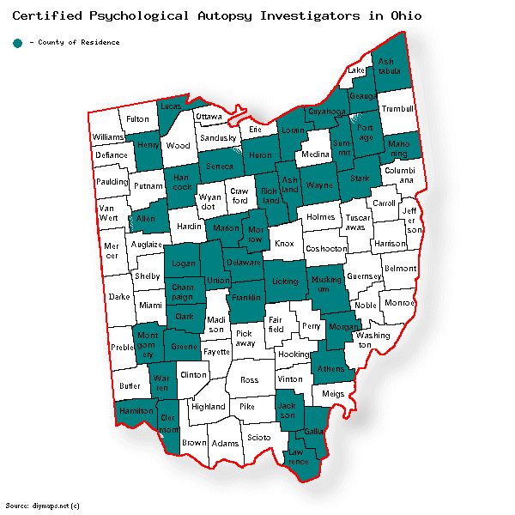
Location of Certified PAIs in Ohio
In 2020, OSPF received funding from the Ohio Department of Mental Health & Addiction Services (OhioMHAS) to provide up to 100 people in Psychological Autopsy Certification Training (PACT).
  OH ended up training 116 people through 2022.
  74 went on to become certified to do the work (76 total in OH*)
NOVEMBER 12, 2024
COLUMBUS, OHIO
OHIO SUICIDE FATALITY REVIEW BEST PRACTICES SUMMIT

Slide 13
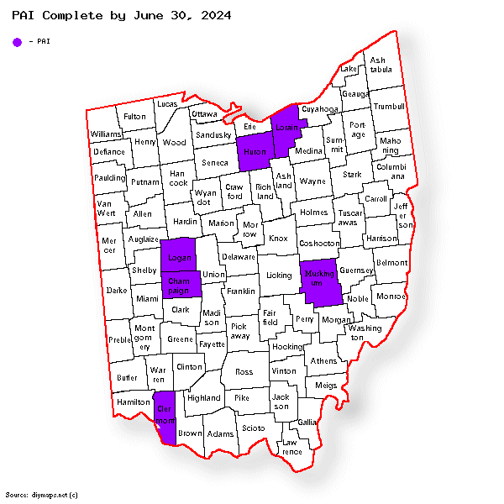
2024 PAI Pilot Project Participants
NOVEMBER 12, 2024
COLUMBUS, OHIO
OHIO SUICIDE FATALITY REVIEW BEST PRACTICES SUMMIT

Slide 14
Retrospective Fatality Analysis (RFA)
A.K.A. another version of Psychological Autopsy.
Developed by a multidisciplinary team of seven highly experienced death investigators and suicidologists.
Coroners, Death Investigators, MH Boards, Health Department staff are all great trainee candidates.
Could help in equivocal death situations/determinations.
NOVEMBER 12, 2024
COLUMBUS, OHIO
OHIO SUICIDE FATALITY REVIEW BEST PRACTICES SUMMIT

Slide 15
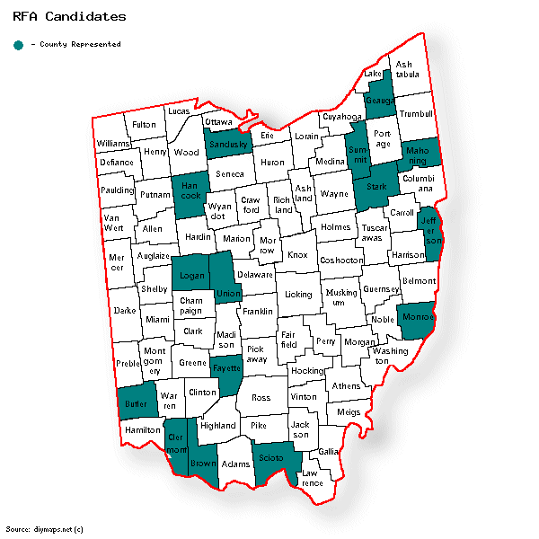
2025 RFA Candidates
NOVEMBER 12, 2024
COLUMBUS, OHIO
OHIO SUICIDE FATALITY REVIEW BEST PRACTICES SUMMIT

Slide 16
Vision: Integrate PAIs within SFR Infrastructure
According to surveys completed by both SFR and PAI surveys, the majority of respondents want to collaborate with each other and learn more.
PAI investigations investigate further into psychosocial history and happen sooner after a suicide loss (3-9 months postmortem).
Intersection of SMRCs and PAIs has the potential to improve the local suicide prevention, intervention, and postvention initiatives in Ohio.
NOVEMBER 12, 2024
COLUMBUS, OHIO
OHIO SUICIDE FATALITY REVIEW BEST PRACTICES SUMMIT

Slide 17
Benefits to Integrating SFRs and PAIs at Local Level
Members of SMRCs are rooted in the community they represent
  May have local organizations/professionals that represent the background of the decedent
  PAIs might be from outside of the community, and may not have connections like members of a local SMRC
PAIs investigate rigorously beyond the operations of a SMRC
NOVEMBER 12, 2024
COLUMBUS, OHIO
OHIO SUICIDE FATALITY REVIEW BEST PRACTICES SUMMIT

Slide 18
Next Steps & How to Get Involved
Have death investigators & other stakeholders participate in RFA training opportunities.
  January 23-24, 2025
Familiarize yourselves with the new Ohio SFR Manual.
  How to engage partners
  Benefits to community suicide prevention efforts
Integrating Psych Autopsy Investigators into the operation of fatality review boards
  Create script and contact list, facilitate introductions
Creation of standard consent forms (templates) and record request to conduct interviews and reviews.
NOVEMBER 12, 2024
COLUMBUS, OHIO
OHIO SUICIDE FATALITY REVIEW BEST PRACTICES SUMMIT

Slide 19
NOVEMBER 12, 2024
COLUMBUS, OHIO
Thank You
OHIO SUICIDE FATALITY REVIEW BEST PRACTICES SUMMIT
Questions?

Slide 20





Contact Us
Austin Lucas
Dallas Allen
614-429-1528
614-525-2037
ohiospf.org
Dallas.Allen@franklincountyohio.gov
Austin.lucas@ohiospf.org

