Slide 1






Best Practices for Combined SFR/OFR Committees
NOVEMBER 12, 2024
COLUMBUS, OHIO
Presented by: Hancock Public Health, Huron County Public Health, and Zanesville-Muskingum County Health Department
OHIO SUICIDE FATALITY REVIEW BEST PRACTICES SUMMIT

Slide 2
Session objectives:
Learn about some of the Ohio Revised Code concerning SFRs
Compare and contrast LHDs presenting in this session
Discuss benefits of hybrid SFR-OFR committees
Discuss cons of hybrid SFR-OFR committees
Discuss recommendations and best practices regarding hybrid SFR-OFR committees
NOVEMBER 12, 2024
COLUMBUS, OHIO
OHIO SUICIDE FATALITY REVIEW BEST PRACTICES SUMMIT

Slide 3
Authorization for Hybrid Review Committee
“A board of county commissioners may appoint a health commissioner of the board of health of a city or general health district that is entirely or partially located in the county in which the board of county commissioners is located to establish a hybrid drug overdose fatality and suicide fatality review committee to review drug overdose deaths, opioid-involved deaths, and deaths by suicide occurring in the county.”
See https://codes.ohio.gov/ohio-revised-code/section-307.6410
NOVEMBER 12, 2024
COLUMBUS, OHIO
OHIO SUICIDE FATALITY REVIEW BEST PRACTICES SUMMIT

Slide 4
Ohio Revised Code
Establishing an SFR – Section 307.641
Required Members – Section 307.642
  Chief of Police/County Sheriff
  Public Health Official
  Executive Director of ADAMHS Board
  Physician
Annual Report – Section 307.646
  Due to ODH by April 1st
Providing information to SFR – Section 307.647
  (A)(3) “… a county coroner shall make available to the review committee the coroner's full and complete record…”
Confidentiality – Section 307.649
Hybrid Review Committee – Section 307.6410
NOVEMBER 12, 2024
COLUMBUS, OHIO
OHIO SUICIDE FATALITY REVIEW BEST PRACTICES SUMMIT

Slide 5
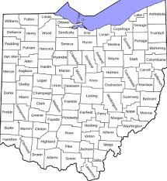
Background on Presenting Counties
  Hancock County, Huron County, and Zanesville-Muskingum County
NOVEMBER 12, 2024
COLUMBUS, OHIO
OHIO SUICIDE FATALITY REVIEW BEST PRACTICES SUMMIT

Slide 6
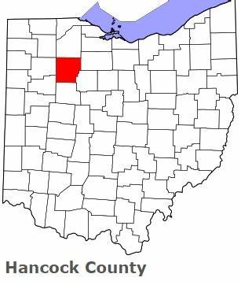

Hancock County
NOVEMBER 12, 2024
COLUMBUS, OHIO
OHIO SUICIDE FATALITY REVIEW BEST PRACTICES SUMMIT

Slide 7
Hancock County
Rural county located in northwest Ohio
Population of Hancock County is 55,457
Largest city is Findlay, population 40,313
NOVEMBER 12, 2024
COLUMBUS, OHIO
OHIO SUICIDE FATALITY REVIEW BEST PRACTICES SUMMIT

Slide 8
Hancock County SOFR
Combined Overdose fatality review and suicide fatality review
Facilitated by Hancock Public Health
Started reviewing Overdoses in 2016
Fully funded position for SOFR through the SOS grant, and local mental health board
NOVEMBER 12, 2024
COLUMBUS, OHIO
OHIO SUICIDE FATALITY REVIEW BEST PRACTICES SUMMIT

Slide 9
Hancock county SOFR Committee
Local ADAMHS Board
Local police department
County Sheriffs office
Adult probation
Juvenile probation (if applicable to case)
Local School district (if applicable to case)
Local hospital system
Pain management
Veteran affairs
Local behavioral health facilities
Coroner is invited (often doesn’t attend)
NOVEMBER 12, 2024
COLUMBUS, OHIO
OHIO SUICIDE FATALITY REVIEW BEST PRACTICES SUMMIT

Slide 10
Hancock county SOFR
Meetings are held quarterly
In 2021 20 deaths by suicide were reviewed
IN 2021 20 overdose deaths were reviewed
IN 2022 28 deaths by suicide were reviewed
In 2022 20 overdose deaths were reviewed
Still waiting on 2023 death certificates for final numbers
NOVEMBER 12, 2024
COLUMBUS, OHIO
OHIO SUICIDE FATALITY REVIEW BEST PRACTICES SUMMIT

Slide 11
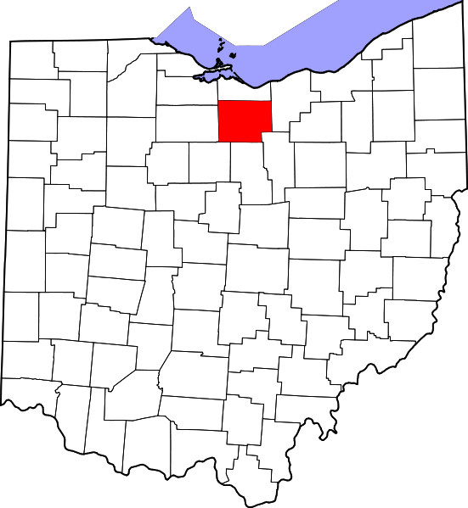

NOVEMBER 12, 2024
COLUMBUS, OHIO
OHIO SUICIDE FATALITY REVIEW BEST PRACTICES SUMMIT

Slide 12
Hancock County
Rural county located in northwest Ohio
Population of Hancock County is 55,457
Largest city is Findlay, population 40,313
NOVEMBER 12, 2024
COLUMBUS, OHIO
OHIO SUICIDE FATALITY REVIEW BEST PRACTICES SUMMIT

Slide 13
Huron County Drug Overdose & Suicide
Fatality Review Committee
Hybrid committee – combined SFR/OFR
Facilitated by Huron County Public Health
First meeting was held on July 27, 2022
Currently unfunded, but will receive $10,000.00 in SFY25 through the Ohio Department of Health’s Youth Suicide Prevention Grant
NOVEMBER 12, 2024
COLUMBUS, OHIO
OHIO SUICIDE FATALITY REVIEW BEST PRACTICES SUMMIT

Slide 14
Huron County SOFR Committee Makeup
Huron County Public Health
Huron County Board of Mental Health and Addiction Services*
Huron County Coroner
Law Enforcement:
  Huron County Sheriff’s Office
  City of Norwalk Police Department
First Responders:
  Willard Fire & Rescue
Mental Health/Substance Use Treatment Agencies:
  Family Life Counseling
  Firelands Counseling & Recovery Services
  Oriana House
Veteran-Serving Organizations:
  VA Northeast Ohio Healthcare System
  Huron County Veteran Service Office
Huron County Prosecutor’s Office
Evans Funeral Home
Mercy Health – Willard Hospital
Huron County Department of Job & Family Services
NOVEMBER 12, 2024
COLUMBUS, OHIO
OHIO SUICIDE FATALITY REVIEW BEST PRACTICES SUMMIT

Slide 15
Huron County Drug Overdose & Suicide
Fatality Review Committee
Quarterly meeting cadence
  Review suicide and overdose-related deaths that occurred two quarters prior (example: April, May and June cases are reviewed in October)
    Having this build-in delay allows members time to investigate deaths and collect needed information
All Huron County resident suicide/overdose deaths that occur in Huron County are reviewed by the Committee (excluding cases with ongoing investigations, these could be reviewed later)
  2022 – 9 cases reviewed (two meetings – July & October)
  2023 – 23 cases reviewed
  2024 – 15 cases reviewed (count includes January, April, July meetings)
NOVEMBER 12, 2024
COLUMBUS, OHIO
OHIO SUICIDE FATALITY REVIEW BEST PRACTICES SUMMIT

Slide 16
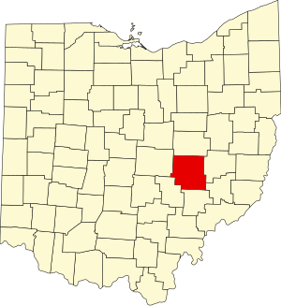

Zanesville-Muskingum County Health Department
(ZMCHD)
NOVEMBER 12, 2024
COLUMBUS, OHIO
OHIO SUICIDE FATALITY REVIEW BEST PRACTICES SUMMIT

Slide 17
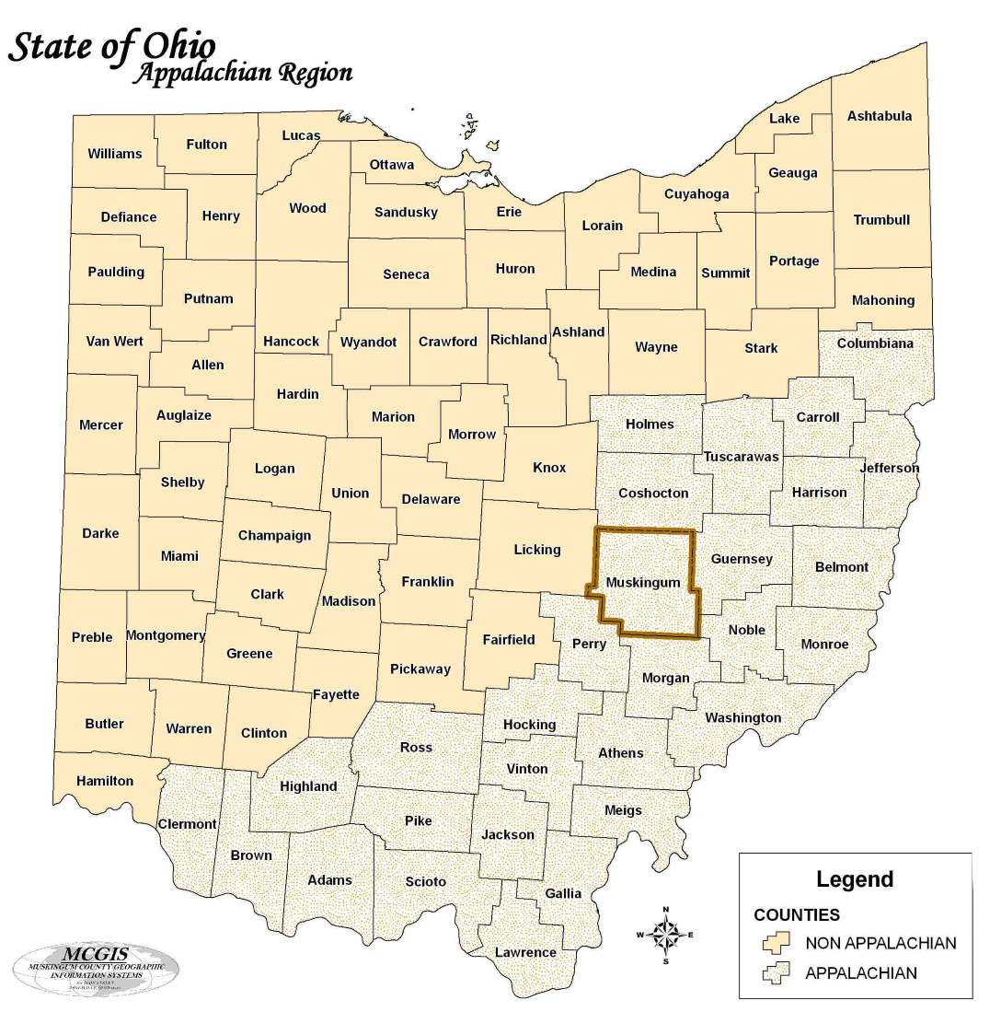
Muskingum County, Ohio
Rural, Appalachian County located in Southeastern Ohio
  (<1% of the county's 665 square miles consists of urban areas)
Population: 86,305
Largest City: Zanesville, (pop. 24,651)
Major Industries:
  Educational Services, Health Care, and Social Assistance
  Retail
  Manufacturing
Known for:
  The Y-Bridge
  Tom's Ice Cream Bowl
  Excellent Deer Hunting
NOVEMBER 12, 2024
COLUMBUS, OHIO
OHIO SUICIDE FATALITY REVIEW BEST PRACTICES SUMMIT

Slide 18
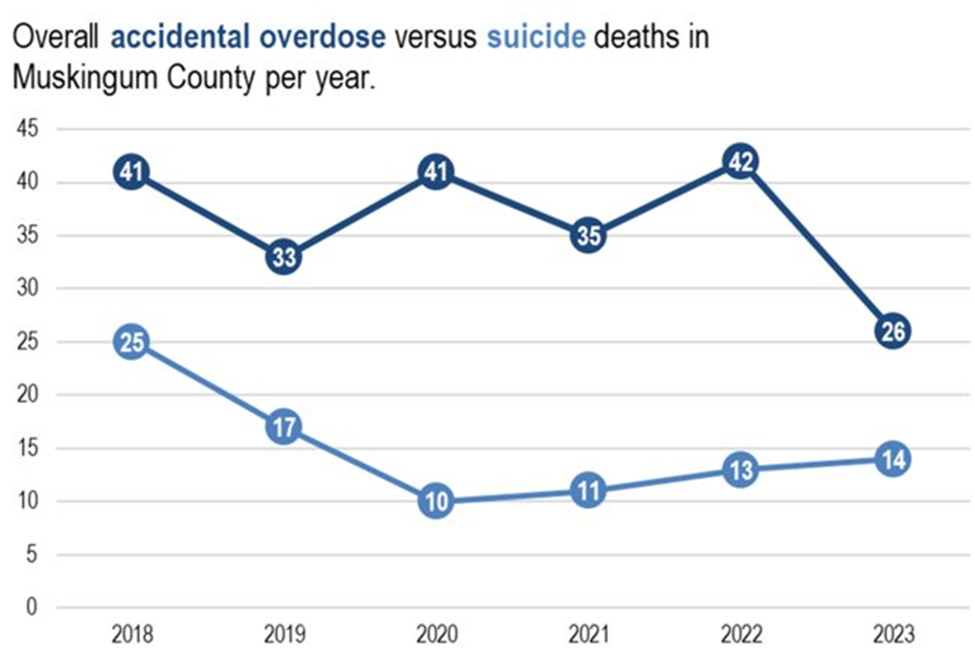
ZMCHD SOFR Committee History
Hybrid committee – combined OFR/SFR
Facilitated by Zanesville-Muskingum County Health Department
First meeting was held in 2018; hybrid since its beginning
Currently unfunded
NOVEMBER 12, 2024
COLUMBUS, OHIO
OHIO SUICIDE FATALITY REVIEW BEST PRACTICES SUMMIT

Slide 19
ZMCHD SOFR Committee Makeup
ZMCHD
  Harm Reduction
  Social Work
  Family Advocate
  Director of Nursing
  Medical Director
  Epidemiologist/SOFR Data Person
  SOFR Facilitator
Muskingum County Coroner
Muskingum County EMA
Muskingum County Prosecutor’s Office
Muskingum Area Board of Mental Health & Recovery Services
Multiple Behavioral Health and Treatment Center partners
Muskingum County Sheriff’s Office
Zanesville Police Department
Genesis HealthCare System
Genesis Community Ambulance Service
Muskingum County Adult and Child Protective Services
NOVEMBER 12, 2024
COLUMBUS, OHIO
OHIO SUICIDE FATALITY REVIEW BEST PRACTICES SUMMIT

Slide 20
ZMCHD SOFR Meeting Schedule
Quarterly meetings
Historically, were reviewing aggregate data only (including combined suicide and overdose deaths occurring in Muskingum County)
  Starting Q2, 2023, began separating Overdose and Suicide data (but still aggregate)
Starting Q3, 2024, first overdose case review
  Planning to perform 1 case review per quarter, ~ 6-month lag
    Q2 = suicide case review (from the prior year)
    Q1, Q3, Q4 = overdose case review
  Will continue to present aggregate data to see trends and choose themes for case reviews
NOVEMBER 12, 2024
COLUMBUS, OHIO
OHIO SUICIDE FATALITY REVIEW BEST PRACTICES SUMMIT

Slide 21
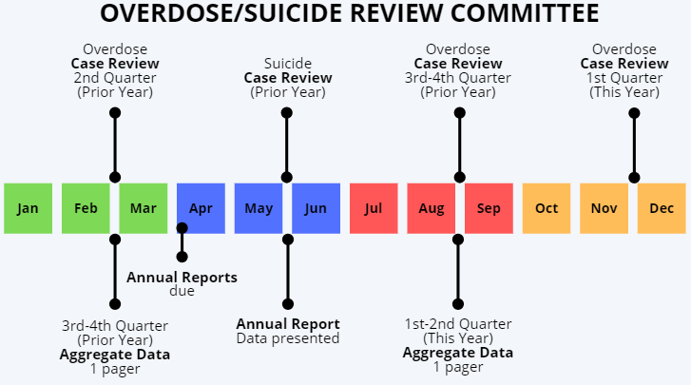
ZMCHD SOFR Meeting Timeline
NOVEMBER 12, 2024
COLUMBUS, OHIO
OHIO SUICIDE FATALITY REVIEW BEST PRACTICES SUMMIT

Slide 22

What is going well vs. barriers:
Good
Large number of community partner agencies are involved/ attend
Aggregate data presentation
Existing committees in the county exist to help with recommendations
Recently partnered with our contact at the Ohio Board of Pharmacy
Needs Work
Still confusion around:
  Ohio Revised Code & Confidentiality
  42 CFR Part 2
  What is expected of partners to prepare for a case review
Hybrid virtual and in-person
NOVEMBER 12, 2024
COLUMBUS, OHIO
OHIO SUICIDE FATALITY REVIEW BEST PRACTICES SUMMIT

Slide 23
Benefits of Hybrid SFR/OFR Committees
NOVEMBER 12, 2024
COLUMBUS, OHIO
Presented by: Kalynn Sommers
Hancock Public Health
OHIO SUICIDE FATALITY REVIEW BEST PRACTICES SUMMIT

Slide 24
Benefits - Logistics
Many of the same people need to be at the table for the SFR and the OFR – especially in a rural community
  Helps with time management – decreased number of partner meetings
  Makes financial sense
  With small numbers, makes the meetings more worthwhile (i.e., not just holding meetings to review one or two cases)
NOVEMBER 12, 2024
COLUMBUS, OHIO
OHIO SUICIDE FATALITY REVIEW BEST PRACTICES SUMMIT

Slide 25
Shared Risk & Prevention Factors
Adverse Childhood Experiences (ACEs) play a role in both suicides and overdoses
Individuals who die by suicide and overdose often have underlying drug and/or mental health issues
Situations in which suicide is not apparent (i.e., no note left behind) make sense to discuss with the combined group of SMEs
  Recommendation: psychological autopsy
Prevention efforts may apply to both suicide and overdose
NOVEMBER 12, 2024
COLUMBUS, OHIO
OHIO SUICIDE FATALITY REVIEW BEST PRACTICES SUMMIT

Slide 26
Cons of Hybrid SFR/OFR Committees
NOVEMBER 12, 2024
COLUMBUS, OHIO
Presented by:
Huron County Public Health
OHIO SUICIDE FATALITY REVIEW BEST PRACTICES SUMMIT

Slide 27
Cons
Depending on committee makeup, could be more stigma towards either overdose or suicide
SFR sometimes gets overshadowed by OFR – if you have larger numbers for overdoses in your community or more subject-matter experts surrounding overdoses
  Can also occur vice-versa if suicide is more prevalent in your area
OFR/SFR case demographics may vary greatly
NOVEMBER 12, 2024
COLUMBUS, OHIO
OHIO SUICIDE FATALITY REVIEW BEST PRACTICES SUMMIT

Slide 28
Recommendations: Best Practices
NOVEMBER 12, 2024
COLUMBUS, OHIO
Presented by: Amanda McPeck
Zanesville-Muskingum County Health Department
OHIO SUICIDE FATALITY REVIEW BEST PRACTICES SUMMIT

Slide 29
Best Practices - Meetings
Break the meeting into distinct sections – discuss all suicide fatalities together and discuss all overdose fatalities together
  Splitting data is important, too!
Make sure that both suicide and overdose deaths get the same amount of attention
  If your county does not review all deaths, make sure it you balance SFR/OFR case reviews
  Make sure you have the right mix of agencies at the table, too.
NOVEMBER 12, 2024
COLUMBUS, OHIO
OHIO SUICIDE FATALITY REVIEW BEST PRACTICES SUMMIT

Slide 30
Best Practices – Next Steps
Any recommendations for the community should come out of your case review meeting
Report-out on your recommendations to the suicide prevention coalition, if your county has one
  Invite your suicide prevention coordinator to attend SFR/OFR meetings
  Start with the intent to connect SFR with your prevention coalition and align your work– this isn’t always the case!
NOVEMBER 12, 2024
COLUMBUS, OHIO
OHIO SUICIDE FATALITY REVIEW BEST PRACTICES SUMMIT

Slide 31
Reminder
Start somewhere!
Our experiences are not meant to discourage you from going in any direction.
Do what you can with what you have and where you’re at today.
What we discussed in this presentation are just ideas to get you operating more efficiently and effectively.
NOVEMBER 12, 2024
COLUMBUS, OHIO
OHIO SUICIDE FATALITY REVIEW BEST PRACTICES SUMMIT

Slide 32
NOVEMBER 12, 2024
COLUMBUS, OHIO
Thank You
OHIO SUICIDE FATALITY REVIEW BEST PRACTICES SUMMIT
For Your Attention

Slide 33
Contact Us
Huron County Public Health
Tim Hollinger, MPH
Health Commissioner
thollinger@huroncohealth.com
567-244-3228
Nicole Marks, MPH
Community Programs Division Director
nmarks@huroncohealth.com
567-244-3225
Hancock Public Health
Kalynn Sommers, OCPRS
Harm Reduction Coordinator/Peer Support Specialist
ksommers@hancockph.com
567-250-5151
Zanesville-Muskingum County
Health Department
Amanda McPeck
Community Health Planner
amandam@zmchd.org
740-454-9741 ext. 253

