Slide 1


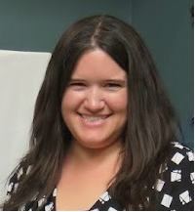







Data Collection, Management, and Reporting
NOVEMBER 12, 2024
COLUMBUS, OHIO
Susan Herzfeld
Lucy Rucker
OHIO SUICIDE FATALITY REVIEW BEST PRACTICES SUMMIT

Slide 2

Learning Objectives
  Identify suicide-related metrics and potential data sources
  Describe two approaches to data management
  Explain required and optional elements of annual report to ODH
NOVEMBER 12, 2024
COLUMBUS, OHIO
OHIO SUICIDE FATALITY REVIEW BEST PRACTICES SUMMIT

Slide 3
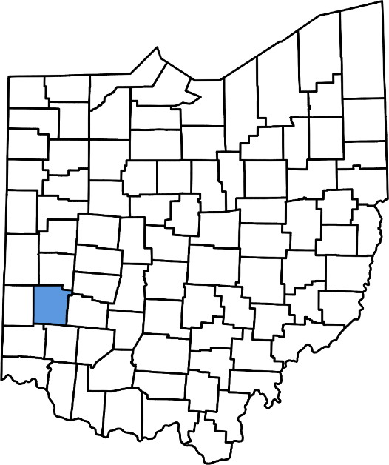
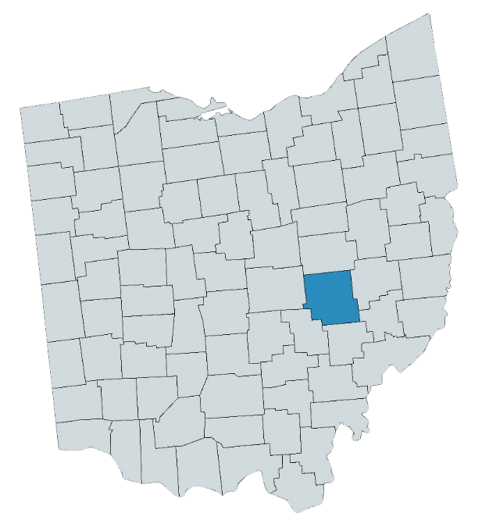
About Us
  Montgomery County
  537,000 Residents
  101 suicides in 2024
  SFR Began in 2021
  Standalone Committee
  Quarterly Meetings
  Behavioral Health Epidemiologist
  Muskingum County
  86,305 Residents
  14 suicides in 2023, 6 in first half of 2024
  SFR/OFR began in 2018
  Hybrid Committee
  Quarterly Meetings
  Epidemiologist, Community Engagement and Performance Management
NOVEMBER 12, 2024
COLUMBUS, OHIO
OHIO SUICIDE FATALITY REVIEW BEST PRACTICES SUMMIT

Slide 4

Key Data Points for Case Review
  Data collection for case review is more time and resource intensive. Information may be more in-depth, and in a narrative format.
  Goal: Understand contributors to a specific suicide and develop recommendations to prevent future deaths.
Personal History Medical History Chronic or Terminal Illness Changes in prognosis Mental Health History Prior Screenings Social Support Systems Financial Status Housing Stability Employment Difficulty Substance use history and recovery
Suicide Risk Recent changes or sources of stress Legal, relationship, health, economic Exposure to suicide Access to lethal means Prior suicide attempts History of Self Harm Recent signs of suicidal thought Protective factors
NOVEMBER 12, 2024
COLUMBUS, OHIO
OHIO SUICIDE FATALITY REVIEW BEST PRACTICES SUMMIT

Slide 5
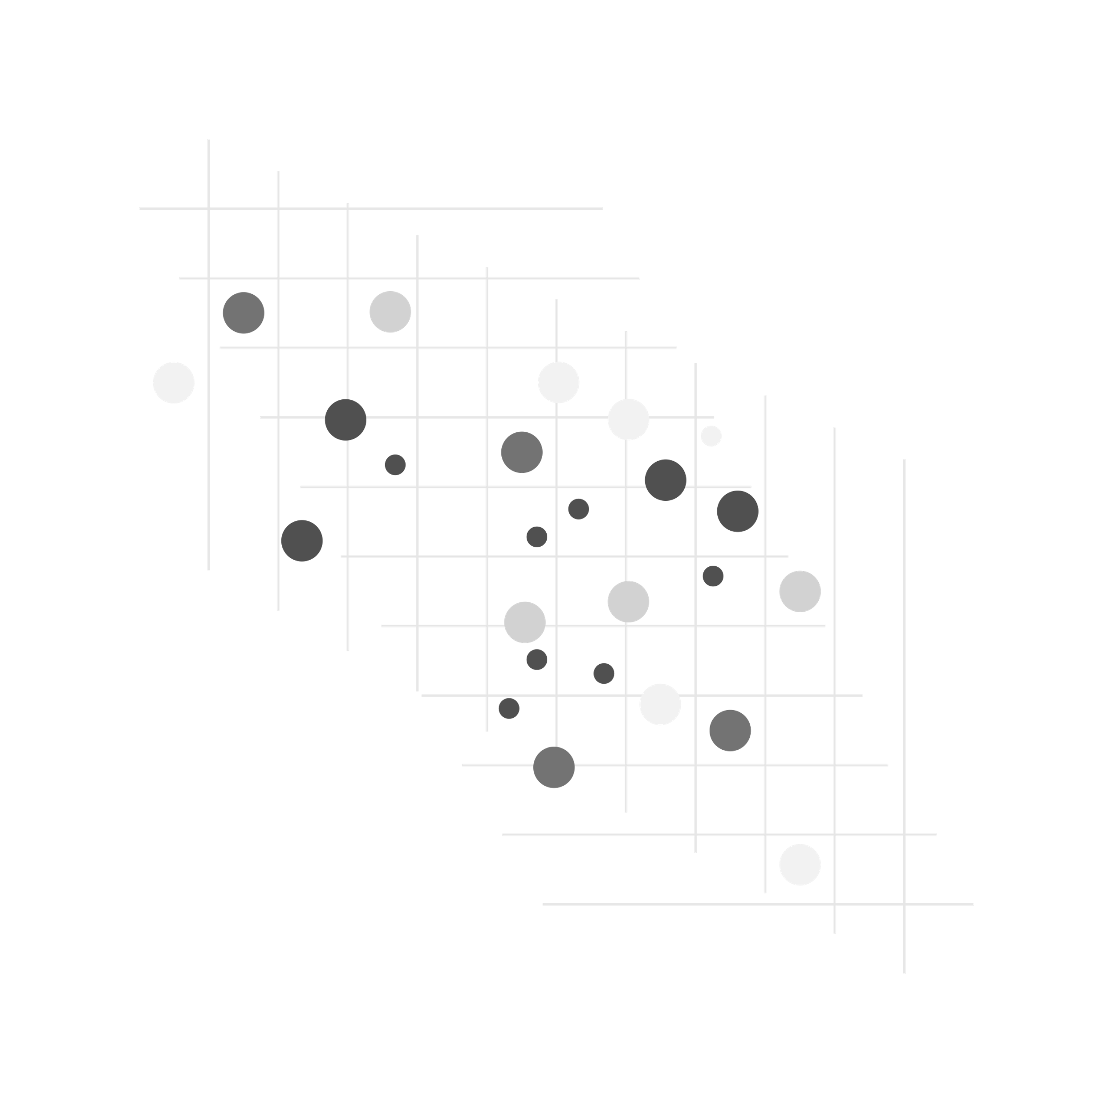
Key Data Points for Aggregate Data
  Aggregate data analysis can be conducted for information that is more easily and consistently collected and recorded.
  Goal: Identify trends to inform prevention efforts.
  Demographic Information
    Age, Sex, Race
    Education, Occupation
  Circumstances
    Method, Toxicology, Location, Note
  Recent Stressors
    Legal, relationship, financial
  Known physical or mental health conditions
  Prior attempts, thoughts, or self-harm
  Exposure to suicide
  Other records as available
    Medical, Criminal Justice, etc.
NOVEMBER 12, 2024
COLUMBUS, OHIO
OHIO SUICIDE FATALITY REVIEW BEST PRACTICES SUMMIT

Slide 6

Data Sources
  Coroner’s Office
  Vital Statistics/ Death Certificate
  Criminal Justice Records
  Hospital Systems
  Mental Health Boards
  Fire/EMS Records
  OARRS
  Children’s Services
  Postvention Support Systems
  Next of Kin Interviews/Psychological Autopsies
  Obituaries
  Social Media
NOVEMBER 12, 2024
COLUMBUS, OHIO
OHIO SUICIDE FATALITY REVIEW BEST PRACTICES SUMMIT

Slide 7

Data Collection Challenges/ Solutions
  Partners unwilling to share data
  Partners unable to share data
  Data not received in an easy-to-use format
  Don’t know where to find data
  No existing partnership with data sources
  Lack of staff time or knowledge to organize data
  Strategies to overcome these challenges:
  Educating committee members
  Confidentiality and Nondisclosure agreements
  Building trust
  Building new community partnerships
  Fund the SFR so resources can be dedicated to it (eventually)
NOVEMBER 12, 2024
COLUMBUS, OHIO
OHIO SUICIDE FATALITY REVIEW BEST PRACTICES SUMMIT

Slide 8
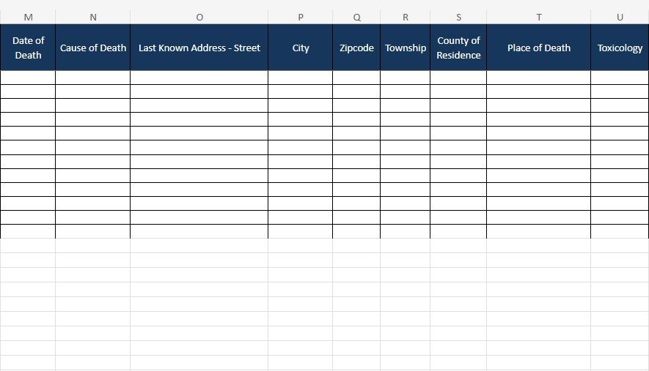
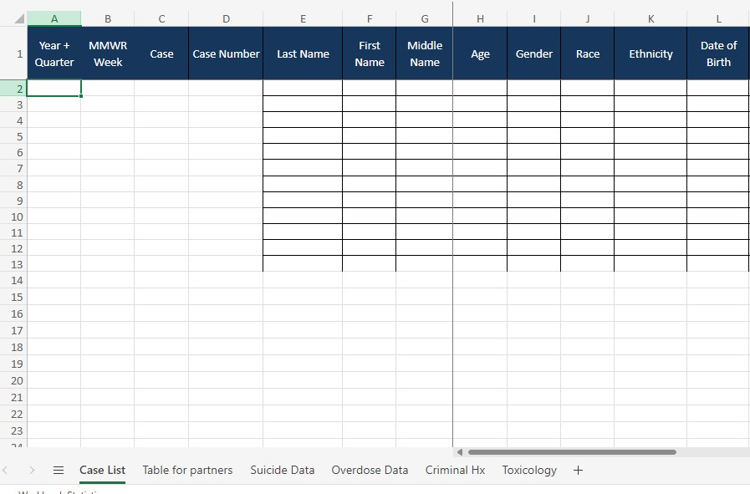
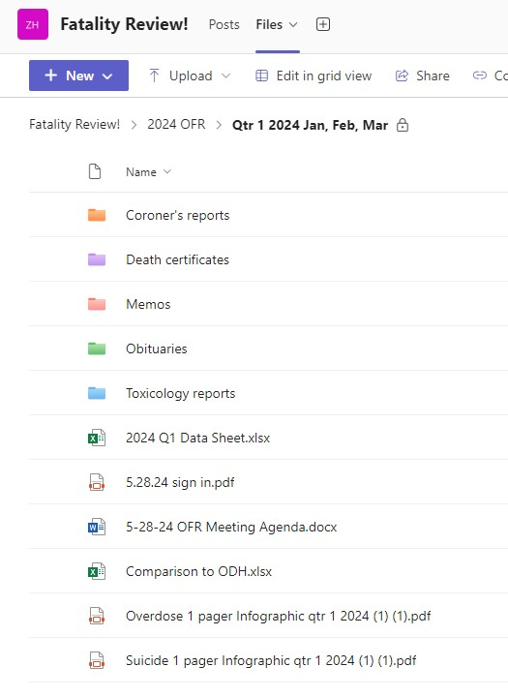
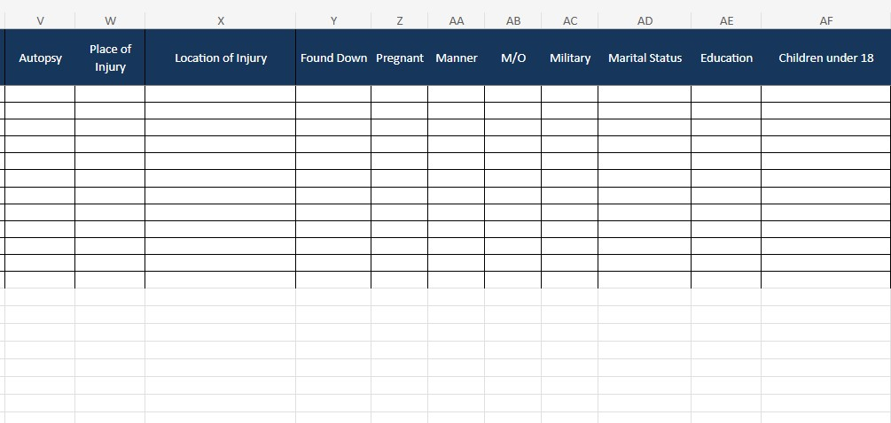
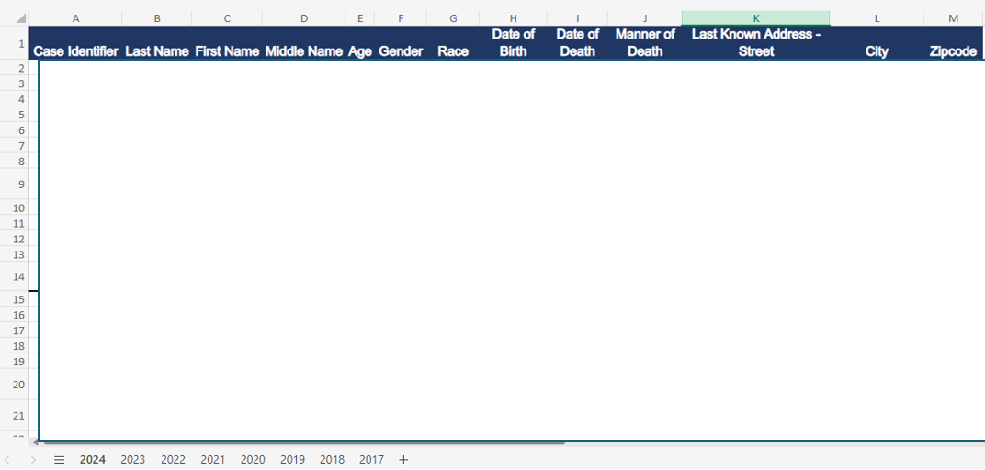
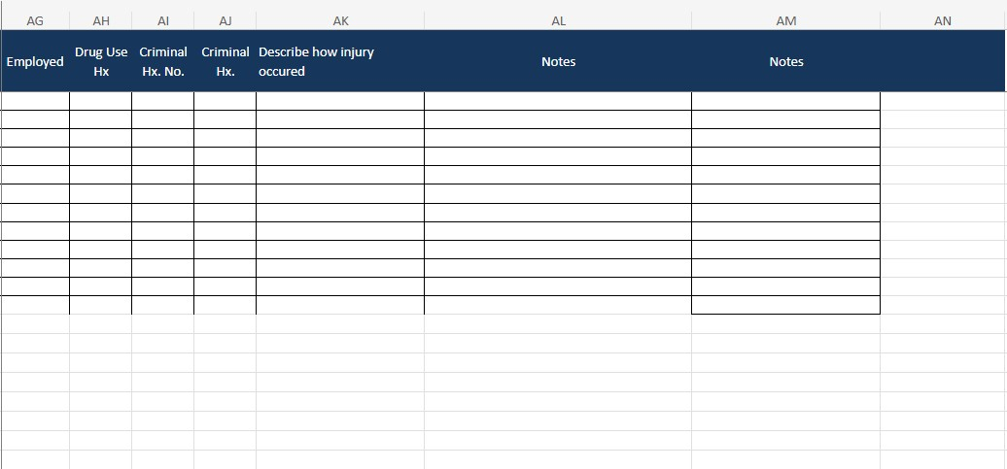
Data Management – Teams/ Excel
  Locked Teams channel
  Folder for each time-frame (quarterly and annual report)
    Excel spreadsheet
      Many tabs
      Detailed
      Make graphs for presentations here
    Sub folders for obituaries, death certificates, etc.
  Master list
    Minimum info
    Tab for each year
NOVEMBER 12, 2024
COLUMBUS, OHIO
OHIO SUICIDE FATALITY REVIEW BEST PRACTICES SUMMIT

Slide 9
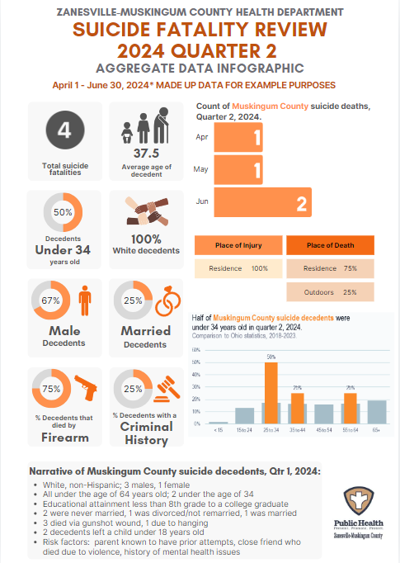
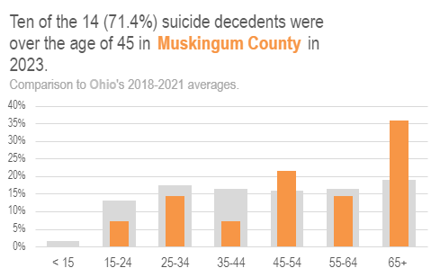
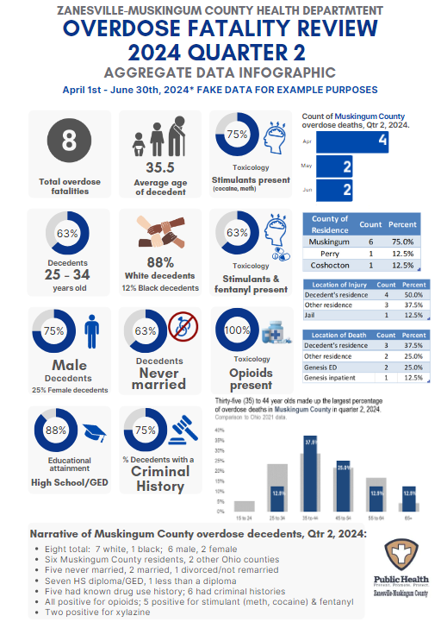
Data Management – Teams/ Excel
  Aggregate data
    Quarterly synopsis
      1-pager infographic
    Annually
      PowerPoint presentation
      Annual report
      1-pager infographic
  Since our committee is hybrid, I color-code presentations/data
    Overdose = blue
    Suicide = orange
NOVEMBER 12, 2024
COLUMBUS, OHIO
OHIO SUICIDE FATALITY REVIEW BEST PRACTICES SUMMIT

Slide 10
Data Management - Excel
Benefits
Might be hard to keep up with data entry if you are in a county with many decedents
Challenges
Everyone probably has access to Excel
Can make graphs in the spreadsheets where you are housing the data/ no need to export
NOVEMBER 12, 2024
COLUMBUS, OHIO
OHIO SUICIDE FATALITY REVIEW BEST PRACTICES SUMMIT

Slide 11



Data Management - Access
ODH Mortality Spreadsheet
Excel
Analyze and Create Data Visualizations
Import
Microsoft Access Database
Organize and Recode Data
Export
Coroner Spreadsheet
Import
Tableau
Analyze and Create Dashboards
Export
Enter Into Form
Additional Data
Abstracted ODH and Coroner Data
Criminal Justice
Obituary
Misc.
NOVEMBER 12, 2024
COLUMBUS, OHIO
OHIO SUICIDE FATALITY REVIEW BEST PRACTICES SUMMIT

Slide 12
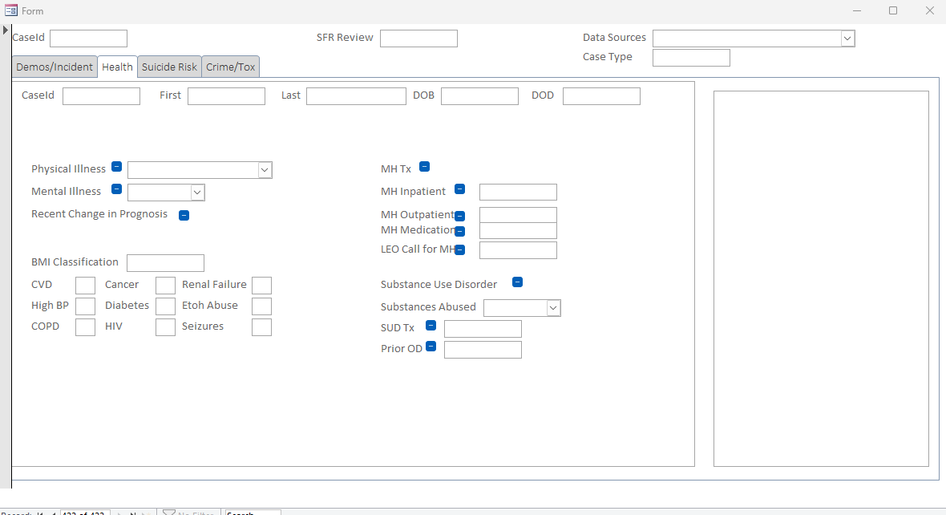
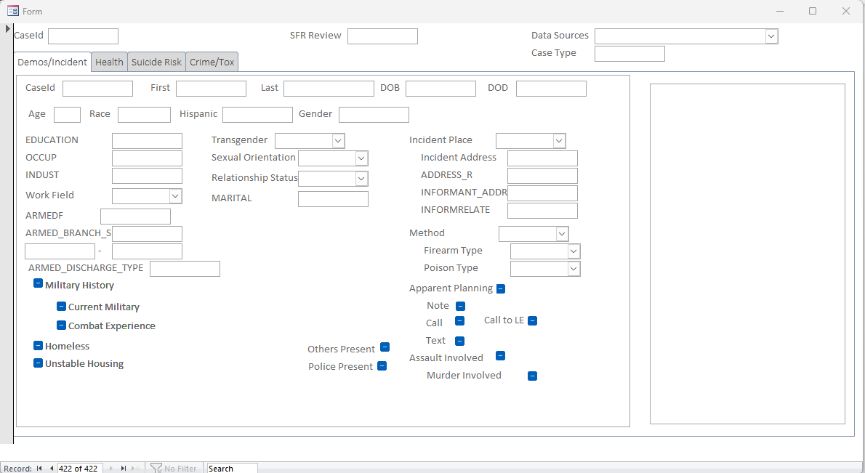
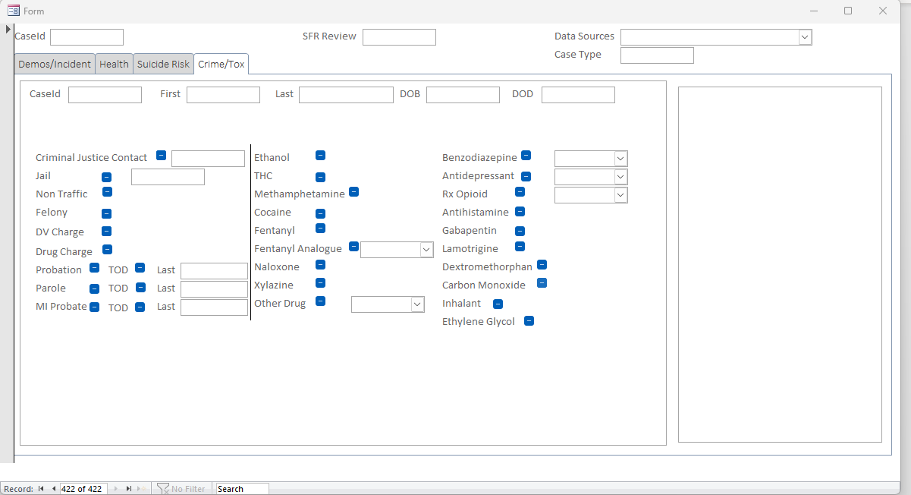
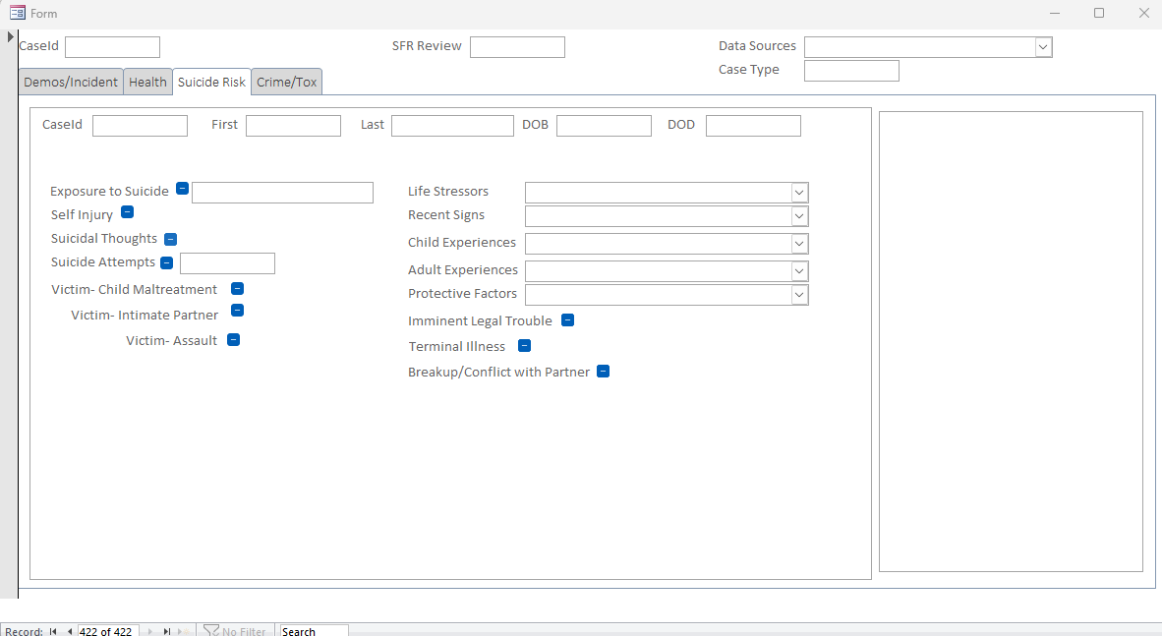
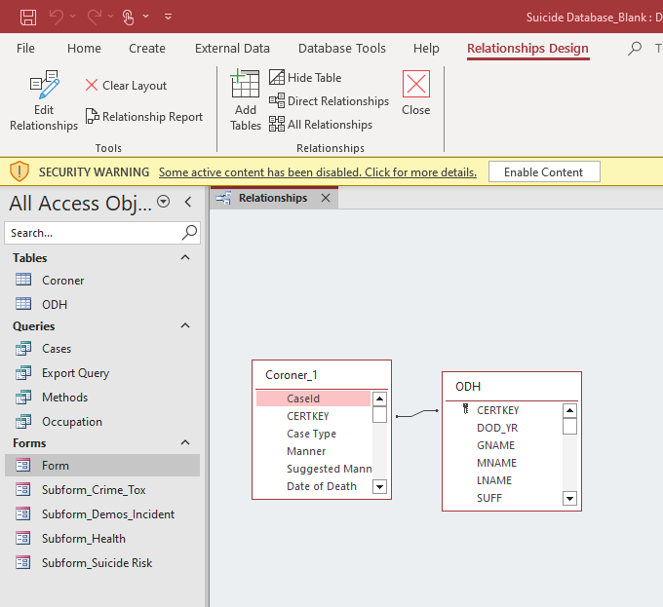
Data Management - Access
NOVEMBER 12, 2024
COLUMBUS, OHIO
OHIO SUICIDE FATALITY REVIEW BEST PRACTICES SUMMIT

Slide 13
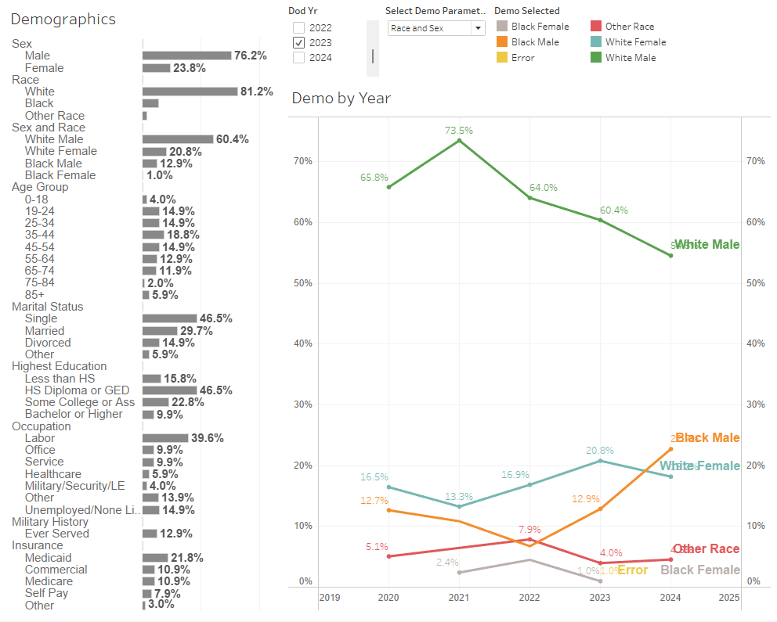
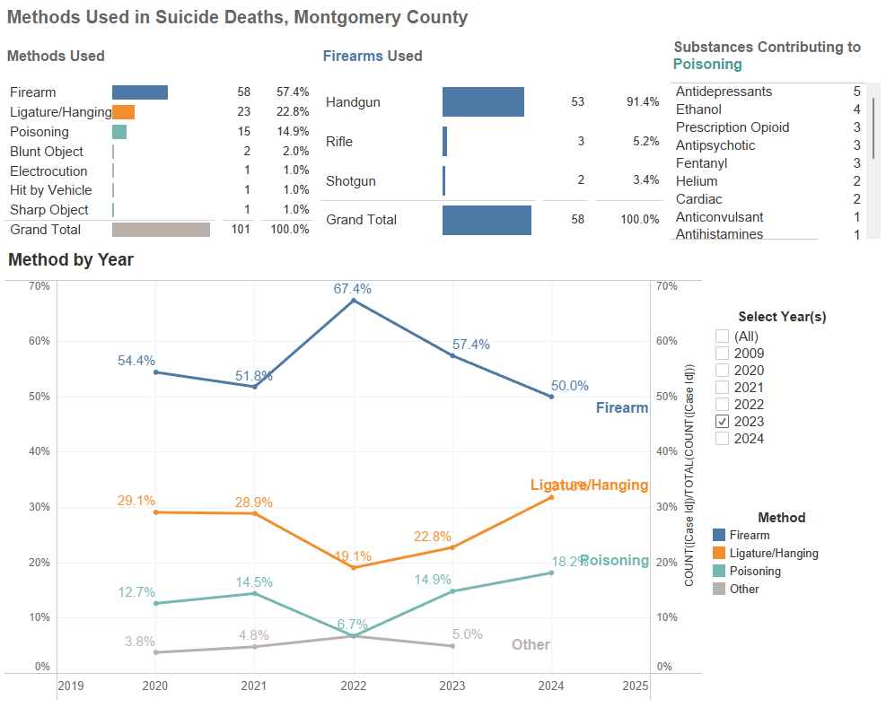
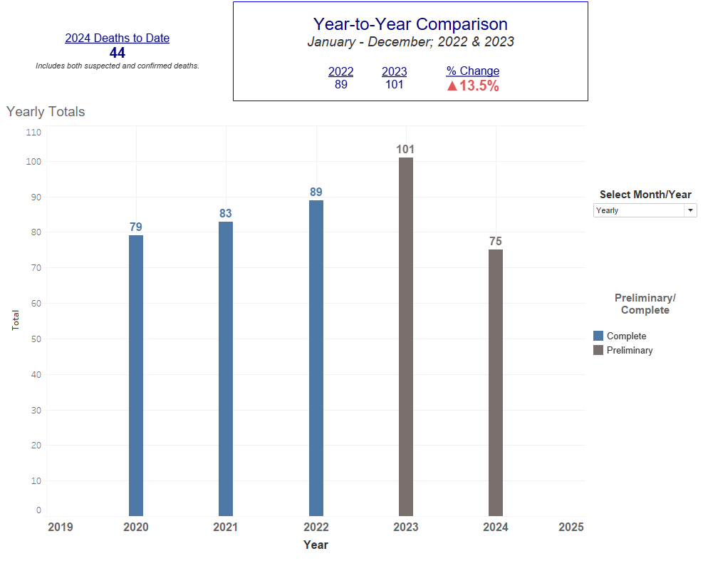
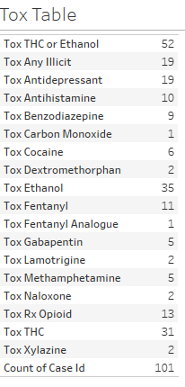
Data Management - Tableau
NOVEMBER 12, 2024
COLUMBUS, OHIO
OHIO SUICIDE FATALITY REVIEW BEST PRACTICES SUMMIT

Slide 14
Data Management - Access
Benefits
Steep Learning Curve
Time Intensive to Create
Challenges
Import and Export Formatted Information
Consistent Data Collection
Preserve Underlying Data During Analysis
NOVEMBER 12, 2024
COLUMBUS, OHIO
OHIO SUICIDE FATALITY REVIEW BEST PRACTICES SUMMIT

Slide 15
Community Reporting - Aggregate Data
  Types of Reports
  Trends in total suicides
    Include suspected deaths if available
  Monthly/Quarterly reporting as deaths are finalized
  Final Annual Reports
  Data Requests
  Considerations in Reporting
  Clear messaging
  Inform prevention
  Language matters
NOVEMBER 12, 2024
COLUMBUS, OHIO
OHIO SUICIDE FATALITY REVIEW BEST PRACTICES SUMMIT

Slide 16
Community Reporting - Aggregate Data
NOVEMBER 12, 2024
COLUMBUS, OHIO
OHIO SUICIDE FATALITY REVIEW BEST PRACTICES SUMMIT

Slide 17
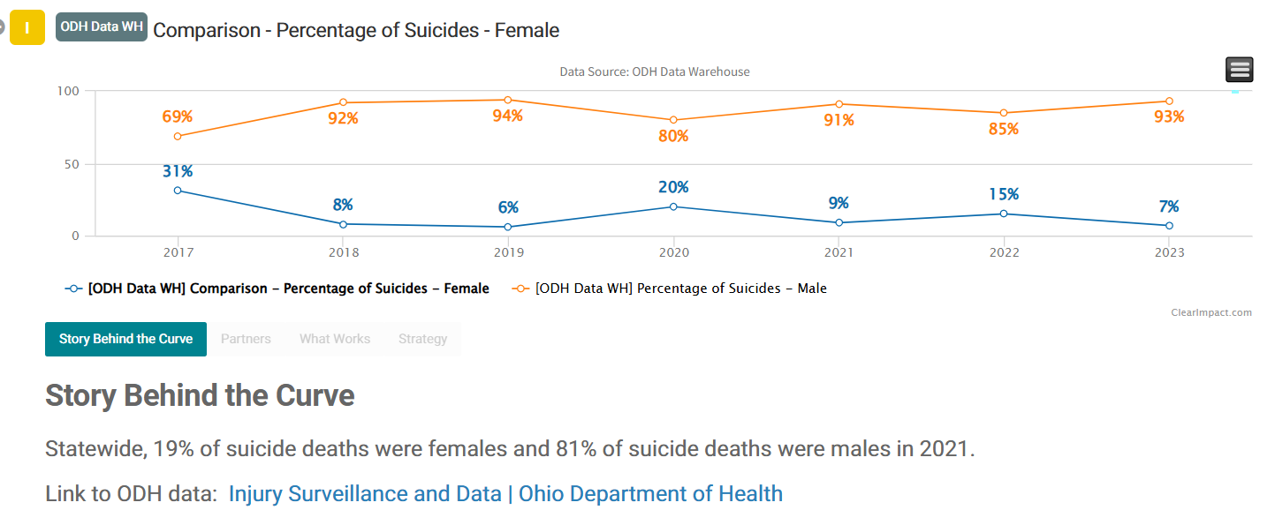
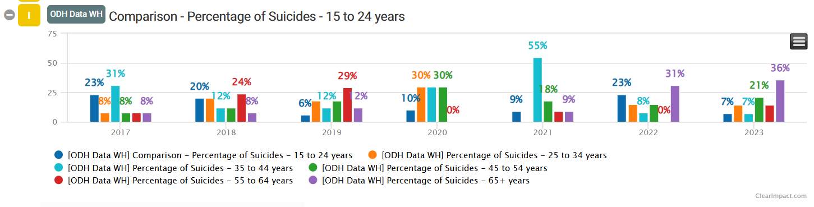
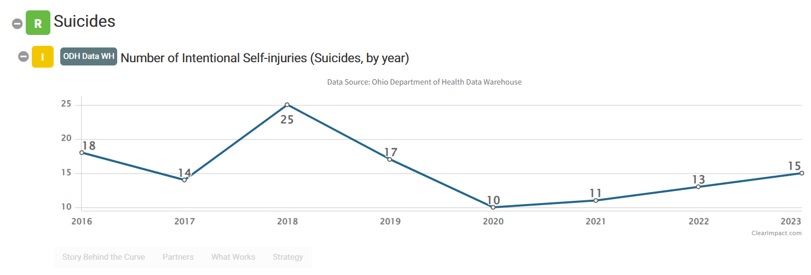
Community Reporting - Aggregate Data
  Clear Impact
  Dashboard/ performance management software offered to LHDs through ODH
  We have a Harm Reduction dashboard on our website
NOVEMBER 12, 2024
COLUMBUS, OHIO
OHIO SUICIDE FATALITY REVIEW BEST PRACTICES SUMMIT

Slide 18

Community Reporting – SFR Findings/Recommendations
  Themes may arise out of case review, including:
    Prior trauma
    Mental Illness
    Painful or terminal physical illness
    Sudden significant legal problems
    Stressors, including relationship, caregiving, financial difficulties.
  Themes can emphasize aggregate findings.
NOVEMBER 12, 2024
COLUMBUS, OHIO
OHIO SUICIDE FATALITY REVIEW BEST PRACTICES SUMMIT

Slide 19
Community Reporting – SFR Findings/Recommendations
  Recommendations that come from the case reviews may need given to a sub-committee or existing coalition to work on
    Track progress
    Report back to SFR
  Example recommendations:
    Increase social opportunities for older individuals, especially those with chronic or terminal illness.
    Suicide prevention outreach to gun shops and ranges- QPR training, postvention services.
    Work with elderly individuals to plan disposition of weapons following death or move to care.
    Education about side effects for medications (psychotic side effects of steroids, cognitive side effects of benzodiazepines)
NOVEMBER 12, 2024
COLUMBUS, OHIO
OHIO SUICIDE FATALITY REVIEW BEST PRACTICES SUMMIT

Slide 20
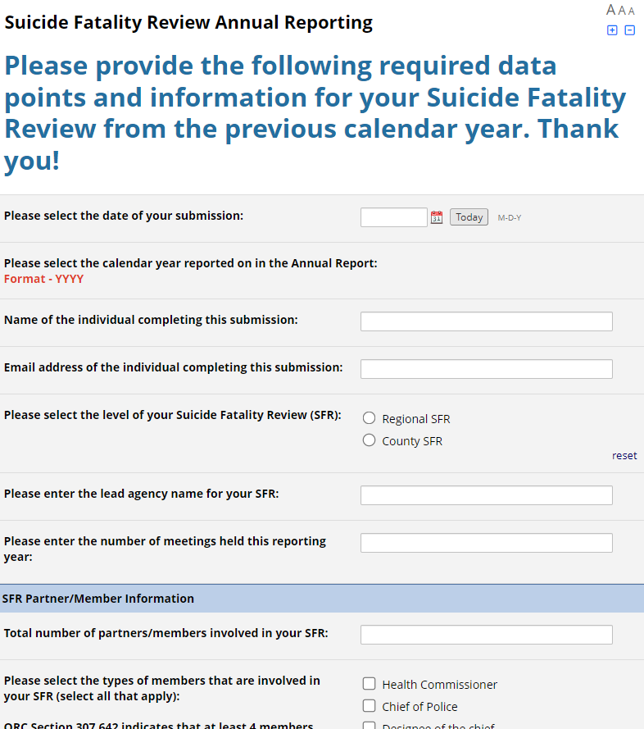
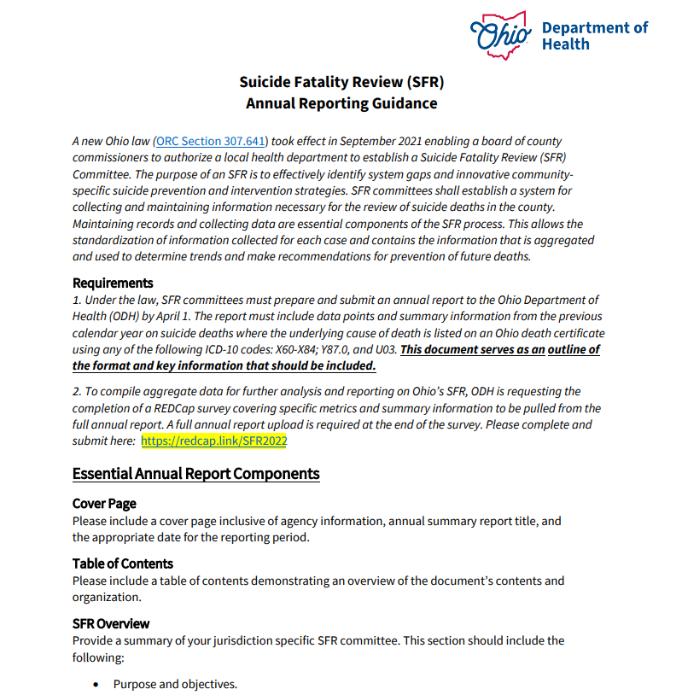
Annual Reporting Requirements
  Required Information
  Total Deaths Occurred
  Total Deaths Reviewed
  Number of Deaths not Reviewed
  Information for cases reviewed:
    Age, sex, race, ethnicity, year of death
  Optional Information
  Toxicology findings
  Factors contributing to the death
  Health factors
  Other history as determined by the committee
Due by April 1st of each year
NOVEMBER 12, 2024
COLUMBUS, OHIO
OHIO SUICIDE FATALITY REVIEW BEST PRACTICES SUMMIT

Slide 21

NOVEMBER 12, 2024
COLUMBUS, OHIO
OHIO SUICIDE FATALITY REVIEW BEST PRACTICES SUMMIT

Slide 22
NOVEMBER 12, 2024
COLUMBUS, OHIO
Thank You
OHIO SUICIDE FATALITY REVIEW BEST PRACTICES SUMMIT
For Your Attention

Slide 23





Contact Us
Susan Herzfeld
Lucy Rucker
(937) 224-3770
(740) 454-9741
www.phdmc.org
www.zmchd.org
LucilleR@zmchd.org
Sherzfeld@phdmc.org
Public Health – Dayton & Montgomery County
Zanesville-Muskingum County Health Department

