Slide 1








SFR Facilitators Best Practices & Corresponding Documentation
NOVEMBER 12, 2024
COLUMBUS, OHIO
Presented by:
Dallas Allen, Franklin County Coroner’s Office
Nicole Marks, MPH, Huron County Public Health
OHIO SUICIDE FATALITY REVIEW BEST PRACTICES SUMMIT

Slide 2
Objectives
Discuss the background of the presenting counties in reference to the Suicide Fatality Review (Franklin, Huron)
Explore the roles and responsibilities of the Suicide Fatality Review facilitator
Examine how the fatality review meetings are conducted and discuss the tasks that are completed before, during, and after a meeting
Review important Suicide Fatality Review related documentation and explore how to overcome common challenges
NOVEMBER 12, 2024
COLUMBUS, OHIO
OHIO SUICIDE FATALITY REVIEW BEST PRACTICES SUMMIT

Slide 3
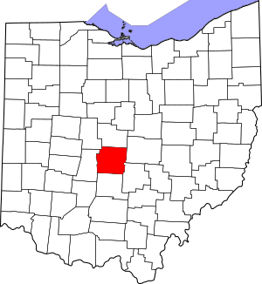
Franklin County, Ohio
Located in Central Ohio and is the central county of the Columbus Metropolitan Statistical Area
The most populated county in the state with an estimated population of 1,326,063 (2023)
One of the most diversely populated counties in Ohio
Largest city: Columbus (913,175 residents in 2023)
Major industries:
  Healthcare and social assistance (107,122 residents)
  Retail Trade (800,236 residents)
  Educational services (65,460 residents)
NOVEMBER 12, 2024
COLUMBUS, OHIO
OHIO SUICIDE FATALITY REVIEW BEST PRACTICES SUMMIT

Slide 4

Franklin County Suicide Fatality Review
  Stand-alone committee
  Facilitated by the Franklin County Coroner’s Office
  First meeting was held on September 3, 2021
  Franklin County’s SFR committee was created before the legislation was enacted
NOVEMBER 12, 2024
COLUMBUS, OHIO
OHIO SUICIDE FATALITY REVIEW BEST PRACTICES SUMMIT

Slide 5
Franklin County SFR Committee Members
Franklin County Coroner’s Office
Nationwide Children’s Hospital
LOSS Community Services (Local Outreach to Suicide Survivors)
Mental Health America of Ohio
Columbus Public Health
Franklin County Public Health
North Central Mental Health Services
Franklin County Sheriff’s Office
Columbus Division of Police
Franklin County Children Services
Ohio Suicide Prevention Foundation
Department of Veterans Affairs
Prevention & Intervention Specialists (Local School District)
Alcohol, Drug, and Mental Health Board of Franklin County
NOVEMBER 12, 2024
COLUMBUS, OHIO
OHIO SUICIDE FATALITY REVIEW BEST PRACTICES SUMMIT

Slide 6
Franklin County Suicide Fatality Review
  Meetings are conducted quarterly (Virtual Meetings)
    Two suicide cases reviewed utilizing full psychosocial investigations
    Information gathered from survivor interviews, public records, social media, medical records, etc.
  Case selection is determined by the Suicide Specialist
    Based on increased risk populations and current community trends
    Examples: Veterans/First responders, LGBTQIA+, and Black Community
  Franklin County Suicide Prevention Coalition
    “Actionable Arm”
    Three action teams: Education, Communication, Data & Research
    Recommendations included in the annual Action Plan for Suicide Prevention
NOVEMBER 12, 2024
COLUMBUS, OHIO
OHIO SUICIDE FATALITY REVIEW BEST PRACTICES SUMMIT

Slide 7
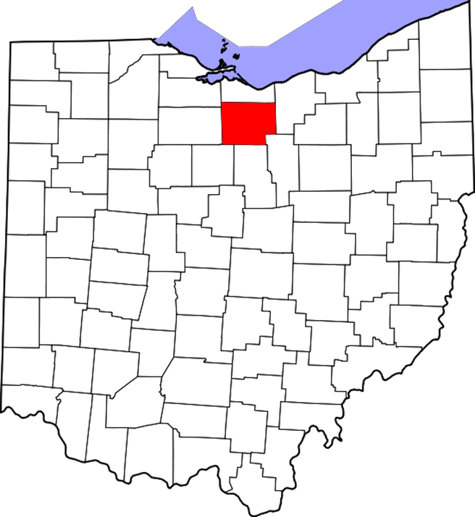
Huron County, Ohio
Rural county located in north central Ohio
Population: 58,565
Largest City: Norwalk with 17,130 residents
Major industries:
  Agriculture
    #1 vegetable producer in the state of Ohio
  Manufacturing
    Examples: Automotive parts, furniture, foods, etc.
NOVEMBER 12, 2024
COLUMBUS, OHIO
OHIO SUICIDE FATALITY REVIEW BEST PRACTICES SUMMIT

Slide 8
Huron County Overdose & Suicide Fatality Review Committee
  Hybrid committee: Combined SFR/OFR
  Facilitated by Huron County Public Health
  First meeting was held on July 27, 2022
  Currently unfunded, but will receive $10,000.00 in SFY25 through the Ohio Department of Health’s Youth Suicide Prevention Grant
NOVEMBER 12, 2024
COLUMBUS, OHIO
OHIO SUICIDE FATALITY REVIEW BEST PRACTICES SUMMIT

Slide 9
Huron County SOFR Committee Makeup
Huron County Public Health
Huron County Board of Mental Health & Addiction Services*
Huron County Coroner
Law Enforcement:
  Huron County Sheriff’s Office
  City of Norwalk Police Department
First Responders:
  Willard Fire & Rescue
Huron County Prosecutor’s Office
Mental Health/Substance Use Treatment Agencies:
  Family Life Counseling
  Firelands Counseling & Recovery Services
  Oriana House
Veteran Serving Organizations:
  VA Northeast Ohio Healthcare System
  Huron County Veteran Service Office
Evans Funeral Home
Mercy Health-Willard Hospital
Huron County Department of Job & Family Services
*Psychological autopsy trained
NOVEMBER 12, 2024
COLUMBUS, OHIO
OHIO SUICIDE FATALITY REVIEW BEST PRACTICES SUMMIT

Slide 10
Huron County Overdose & Suicide Fatality Review Committee
  Quarterly meeting cadence (in-person only)
    Review suicide and overdose related deaths that occurred two quarters prior
      Having this built-in delay allows members time to investigate deaths and collect needed information
  All Huron County resident suicide/overdose deaths that occur in the county are reviewed by the committee, excluding cases still under investigation
    2022: 9 cases reviewed (two meetings-July & October)
    2023: 23 cases reviewed
    2024: 15 cases reviewed (includes January, April, July meetings)
NOVEMBER 12, 2024
COLUMBUS, OHIO
OHIO SUICIDE FATALITY REVIEW BEST PRACTICES SUMMIT

Slide 11
Suicide Fatality Review Facilitators
  Franklin County
    Suicide Investigations & Postvention Specialist, housed at the Franklin County Coroner’s Office
    Created pre-legislation allowing for the Suicide Specialist to be both the chairperson and facilitator
  Huron County
    Chairperson: Health Commissioner, Huron County Public Health
    Facilitator: Community Programs Division Director, Huron County Public Health
NOVEMBER 12, 2024
COLUMBUS, OHIO
OHIO SUICIDE FATALITY REVIEW BEST PRACTICES SUMMIT

Slide 12
Before the meeting…
NOVEMBER 12, 2024
COLUMBUS, OHIO
OHIO SUICIDE FATALITY REVIEW BEST PRACTICES SUMMIT

Slide 13
Prior to Meeting: Franklin County
  Suicide Specialist responds to the scene and assists in the forensic Investigation
    Record demographics, injury location, mechanism, medical history, suicidal ideation, etc.
    Update on-going spreadsheet to highlight trends and compare trends with previous years
  Complete psychosocial interviews (like a psychological autopsy)
    If the committee does not have access to this type of deep-dive, other options include seeking more involvement from the Coroner’s Office (Investigator reports) or conducting next-of-kin interviews
  Prepare report
    Stage 1: Complete investigator narrative with facts known at the time of death
    Stage 2: Collect additional information through public records, social media, medical records, news, and any other outlet that is available to better understand the decedent and their life experiences
    Stage 3: Complete the full psychosocial report that is utilized for the SFR
NOVEMBER 12, 2024
COLUMBUS, OHIO
OHIO SUICIDE FATALITY REVIEW BEST PRACTICES SUMMIT

Slide 14

Prior to Meeting: Franklin County (continued)
  Select Cases to review (typically two cases per meeting)
    Consider cases that have information that can help inform community decisions, actionable change
    Review current trends: Consider at-risk populations
  Prepare for the virtual SFR meetings
    1 month prior: Send out meeting date/reminder
    1-2 weeks prior: Send out case information
      Coroner’s Report/Toxicology Report
      Agenda
      Self-care reminders
      “Trigger warnings”
NOVEMBER 12, 2024
COLUMBUS, OHIO
OHIO SUICIDE FATALITY REVIEW BEST PRACTICES SUMMIT

Slide 15
Prior to Meeting: Huron County
  Establish stable meeting cadence and send a year in advance
  Vital statistics office informs SFR facilitator of all suicide deaths, prints government copy of death certificates for facilitator
  Facilitator adds case(s) to data tracking spreadsheet, adds death certificates to case review binder
  Check in with Huron Co Prosecutor’s Office and Huron County Sheriff’s Office to verify if cases can be reviewed
  Send records requests to list of partners (i.e., hospitals, health providers, EMS, etc.
    As records are received, add to binder
NOVEMBER 12, 2024
COLUMBUS, OHIO
OHIO SUICIDE FATALITY REVIEW BEST PRACTICES SUMMIT

Slide 16
Prior to Meeting: Huron County (continued)
  Compile case obituaries from internet
  Meeting prep:
    Prepare case review forms with information received prior to meeting
    Print sign-in sheet for meeting
  1 week prior to meeting send:
    Meeting reminder
    Agenda (includes list of cases to be reviewed)
NOVEMBER 12, 2024
COLUMBUS, OHIO
OHIO SUICIDE FATALITY REVIEW BEST PRACTICES SUMMIT

Slide 17
Best Practices for Meeting Preparation
  Psychological autopsies or next-of-kin interviews
    Leads to more in-depth conversation
    Increases the likelihood of finding systematic gaps
  Scheduling meetings far in advance and using a consistent recurring meeting cadence
    Leads to increased attendance. Allowing for committee members to make sure that time is clear on their calendars
NOVEMBER 12, 2024
COLUMBUS, OHIO
OHIO SUICIDE FATALITY REVIEW BEST PRACTICES SUMMIT

Slide 18
During the meeting…
NOVEMBER 12, 2024
COLUMBUS, OHIO
OHIO SUICIDE FATALITY REVIEW BEST PRACTICES SUMMIT

Slide 19
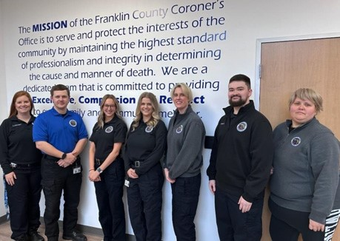
During Meeting: Franklin County
  For each case:
    Review Coroner’s Report/Toxicology
    Review circumstances of death (Investigator narrative)
    Read full psychosocial report (5-6 pages)
  Ask committee members to share any interactions
    Facilitator compiles notes during this discussion
  Collaborative discussion to identify gaps and compile recommendations for actionable change
NOVEMBER 12, 2024
COLUMBUS, OHIO
OHIO SUICIDE FATALITY REVIEW BEST PRACTICES SUMMIT

Slide 20
During Meeting: Huron County
  Opening remarks/review ground rules
  Confidentiality reminder
  Discussion (if any)
  Case reviews
    HCPH presents basic case information compiled from death certificate, obituary, records received
    Partners present case information based on decedent interactions and the info is documented on case review form
    Discuss identified gaps/recommendations for each case
NOVEMBER 12, 2024
COLUMBUS, OHIO
OHIO SUICIDE FATALITY REVIEW BEST PRACTICES SUMMIT

Slide 21

Best Practices for Meeting Facilitation
  Keeping the meeting on task is a key role for the facilitator
  Self-care reminders for Committee members are important to protect their health and well-being
  Give partners ownership in the process by allowing them the time/space to report-out on their experiences and interactions with the decedent
NOVEMBER 12, 2024
COLUMBUS, OHIO
OHIO SUICIDE FATALITY REVIEW BEST PRACTICES SUMMIT

Slide 22
After the Meeting…
NOVEMBER 12, 2024
COLUMBUS, OHIO
OHIO SUICIDE FATALITY REVIEW BEST PRACTICES SUMMIT

Slide 23
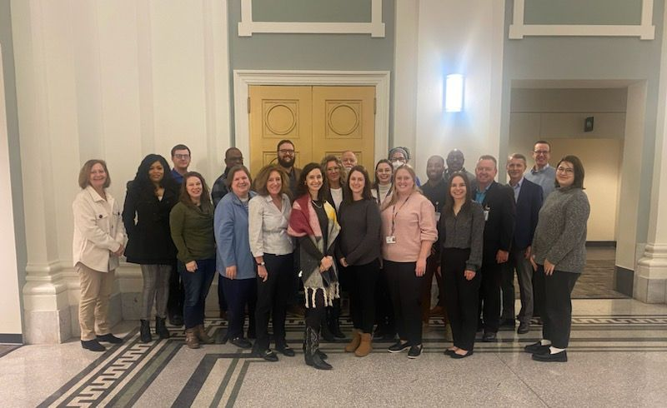

Meeting Follow-up: Franklin County
  Utilize a case review sheet to document all recommendations
  Collaboration with the Suicide Prevention Coalition
    Compile an on-going list of recommendations
    Categorize using the Cascade of Care model
    Work together to implement recommendations
  Check-in with partners, maintain open lines of support
  Continued recruitment to address identified needs
NOVEMBER 12, 2024
COLUMBUS, OHIO
OHIO SUICIDE FATALITY REVIEW BEST PRACTICES SUMMIT

Slide 24
Meeting Follow-up: Huron County
  Scan and save sign-in sheet
  Save case review form
  Collaboration with Huron Crisis Response Committee on recommendations
  Continued recruitment to address needs of the committee
NOVEMBER 12, 2024
COLUMBUS, OHIO
OHIO SUICIDE FATALITY REVIEW BEST PRACTICES SUMMIT

Slide 25

Best Practices for Meeting Follow-up
  Continuously re-evaluate your committee’s membership, think about adding new members or inviting guests as gaps are identified
  Keep case specifics confidential (ORC 307.649)
    Only discuss recommendations with other groups/committees
  Consider asking for assistance with documentation
    Balancing every single task can lead to mistakes
NOVEMBER 12, 2024
COLUMBUS, OHIO
OHIO SUICIDE FATALITY REVIEW BEST PRACTICES SUMMIT
Notes:
Speak to the ORC 307.649: “Any information, document, report presented, all statements made by review committee, all work products of the review committee, and data submitted by the review committee to the department of health, other than the report prepared pursuant to section 307.636 of the Revised Code, are confidential and shall be used by the review committee, its members, and the department of health only in the exercise of the proper functions of the review committee and the department.”

Slide 26
Documentation
NOVEMBER 12, 2024
COLUMBUS, OHIO
OHIO SUICIDE FATALITY REVIEW BEST PRACTICES SUMMIT

Slide 27
Guiding Documents
  Ohio Suicide Fatality Review Manual: Created to provide guidelines on how to develop, implement, and evaluate an effective Suicide Fatality Review
  Huron County: “Implementation Guide” outlines legal authority, purpose, membership, meetings, review criteria, maintenance of information, meeting format, etc.
NOVEMBER 12, 2024
COLUMBUS, OHIO
OHIO SUICIDE FATALITY REVIEW BEST PRACTICES SUMMIT

Slide 28
Important Forms
  Member invitation letter/recruitment letter
  Information request letter
    Not applicable to Franklin County (subpoena power)
  Pre-meeting letter/Agenda
  Sign-in sheet that includes confidentiality statement
    If meeting in person
    If meeting virtually, remember to document attendees from virtual meeting platform
  Confidentiality and/or data sharing agreements
NOVEMBER 12, 2024
COLUMBUS, OHIO
OHIO SUICIDE FATALITY REVIEW BEST PRACTICES SUMMIT
Notes:
If/when Ohio Suicide Fatality Review Manual is released, there are appendices in the toolkit that will give you examples of each of this described documents.
Pre-meeting letter: Allows for each committee member to prepare appropriately to bring information to the meeting for discussion.
Agenda: Can be extremely helpful for the facilitator to keep things on track. Follow the time allotted strictly to ensure every task gets completed.

Slide 29
Case-Related Record Keeping
  Government copies of death certificates
    Collect required information and destroy after meeting
  Data Spreadsheet: Used to compile basic demographics and other information required for annual reporting
  Case Review Form: Used during meetings to compile summary of the information/recommendations
    SFR facilitators must focus on information security
    Ensure that any case related information is secure/confidential
NOVEMBER 12, 2024
COLUMBUS, OHIO
OHIO SUICIDE FATALITY REVIEW BEST PRACTICES SUMMIT
Notes:
Focus on storing any case related information securely. Physical copies of anything must be under lock and key. All virtual information should be password protected.

Slide 30
Annual Report
  ORC Section 307.646 outlines requirements for Annual Report
  Annual Report are public records per ORC Section 149.43
NOVEMBER 12, 2024
COLUMBUS, OHIO
OHIO SUICIDE FATALITY REVIEW BEST PRACTICES SUMMIT

Slide 31

ODH Annual Report Requirements
  “SFR committees must prepare and submit an annual report to the Ohio Department of Health by April 1^{st”}
  REDCap Survey
    Online reporting system utilized to compile aggregate data for further analysis and reporting on Ohio’s SFR
    Essentials components include cover page, table of contents, SFR overview, SFR data and findings, identified trends, recommendations, and next steps
    Suicide Fatality Review annual reporting guidance
NOVEMBER 12, 2024
COLUMBUS, OHIO
OHIO SUICIDE FATALITY REVIEW BEST PRACTICES SUMMIT
Notes:
Suicide Fatality Review annual reporting guidance is on the Ohio Department of Health’s website. Once you navigate to the appropriate section you can download a two-page file that explains everything needed for annual reporting.

Slide 32
NOVEMBER 12, 2024
COLUMBUS, OHIO
Questions?
OHIO SUICIDE FATALITY REVIEW BEST PRACTICES SUMMIT
For Your Attention

Slide 33
Thank you!
Huron County Public Health
Tim Hollinger, MPH
Health Commissioner
thollinger@huroncohealth.com
567-244-3228
Nicole Marks, MPH
Community Programs Division Director
nmarks@huroncohealth.com
567-244-3225
  Franklin County Coroner’s Office
  Dallas Allen
  Suicide Investigations & Postvention Specialist
  Dallas.Allen@franklincountyohio.gov
  614-525-2037
NOVEMBER 12, 2024
COLUMBUS, OHIO
OHIO SUICIDE FATALITY REVIEW BEST PRACTICES SUMMIT

